Slide 1
KEEP YOUR GANG
WE WANT
CHANGE!
Notes:
aaa

Slide 2
Who We Are
Anna Kime - Integrated Practice Project Manager
Russell Gurbutt - Senior Lecturer

Slide 3
What We Would Like to Share
The background to our project
How we developed the programme
What does the programme look like
How we are going to measure our success
What have been the benefits so far
What the future looks like

Slide 4
Our Problem
Increase in life expectancy + Increased incidence of chronic disease= Increased financial burden to local health and social care £££+++
The Kings Fund in 2013 identified a future shortfall in nursing workforce. Impact felt most in Community Care Services
Keith Hurst suggests that 14% of District Nurses are over the age of 50 with 4 % over 60

Slide 5
Establishing Our Vision
Living Longer Living Better (LLLB)(2013) Integrated Health and Social care blueprint for Manchester - the need to shift care from the Acute to the Community
NHS 5 Year Forward View (2014)- there are opportunities now for change within service and education provision
Health Education England (2015) - Public Health agenda key to future sustainability of the NHS

Slide 6
The Lightbulb Moment!
The problem- to future proof the workforce whilst meeting the needs of the local population
We faced a challenge to be different, but we had an unique opportunity – Community and Acute Services in one Division
Partnerships developed across services and networks, driven by Integration as an ideology
We all needed to work together to find a solution
Band 5 Post Graduate Certificate Integrated Rotational Programme ….Not offered anywhere else in the North West Region

Slide 7
Leading the Change
Needed the right academic partner to share our vision , established links with the University of Bolton
Already deliver CPD courses - Community Specialist Practice (District Nurse) and Advanced Practice Programmes
Ability to be flexible, committed and develop a bespoke Post Graduate programme in partnership with CMFT
Change needed to be driven – Successful bid from HENW to become an Integrated Care Demonstrator Site
Funds supported an Integrated Practice Project Manager for 12 months
Stakeholders from Acute, Community and Primary Care

Slide 8
Breaking Down Barriers
Develop a solution that supports the workforce strategy meeting future recruitment and retention demands
Provides a sustainable outcome that encompasses the LLLB agenda
We had an opportunity to transform services and shape a new Integrated Care delivery model within Central Manchester
But we needed to provide the nursing workforce with the skills and knowledge to break down Health and Social care barriers and deliver Integrated Care

Slide 9
The Right Stuff
Two year rotational programme across Acute Medicine, Community and Emergency Care Services
Develop Band 5 Integrated Care Staff Nurses to provide coordinated person centred care across traditional boundaries
Confidence to challenge and change practice.
Clinical competencies designed to enable staff to practice safely across all areas of the Division
Supported by a Mentor in practice
Become part of an adaptable and flexible workforce responsive to the demands of the ever changing Health and Social care environment

Slide 10
Reconnecting With Our Community
Able to meet the needs of patients in each of the care settings
Prioritising the Public Health agenda making every contact count by inspiring patients and their families to manage their own health conditions
Reconnecting patients with the local community and the services available to help reduce avoidable emergency admissions
Increasing care provision in the Community

Slide 11
Future Proofing OurNursing Workforce
Future
Two year Masters level Post Graduate Certificate in partnership with the University of Bolton delivered on site at CMFT underpins the rotation
Utilisation of CMFT and Public Health Library Services
Providing innovative learning environments to facilitate teaching on Integration, Public Health, Leadership and Management Theory
Re-designing career pathways to further enhance and sustain the future workforce

Slide 12
How We Will Measure Our Success
Future
Metrics and Data
Improved staff satisfaction
Increase to the overall number of nursing staff within the Division and particularly within Community Services
Reduction in turnover and costs of temporary staff utilisation
Staff Experience
The Band 5’s will show an increase in the level of knowledge and skills, and confidence by the end of the 2 years
Their values and attitudes to Integrated Care will change throughout the programme , more open to change and feel confident to challenge practice
Patient/Service User Experience
Patient stories or videos will be used to evaluate the patient/service user experience of the current Public Health and Integration agenda
Similar patient/service user experience will be collected towards the end of the project

Slide 13
Benefits and Learning So Far…
Future
Public Health
Scoping and networking has led to the development of a joint training session between CMFT and Public Health Service
Focus on the use of health profiling to determine the Health and Social care needs of the local population
The short interactive course will be piloted and evaluated by the programme with the long term intention to roll out to the wider Community workforce
Competency Framework
The competencies developed for the Community Services rotation are considered transferable and will be used by locality teams
All Band 5 Community Staff will need to develop generic skills to meet the demands of increasing caseloads including clinical, Integrated and Public Health knowledge

Slide 14
Benefits and Learning So Far…cont
Future
Resources
A number of Public Health and Integrated Care resources have been collated by CMFT and Public Health Specialist Library to support the delivery of the programme
These resources will be made available to the wider workforce
Focus groups
Have been delivered to AHPs and Social Workers creating opportunities for future inter-professional learning on Integration and Public Health
Potential for the PG Certificate to become multi-professional supported by specialist rotational programmes
Primary care
Increased links developed with Primary Care and Out of Hours Services
Strengthened working relationships between the Division and Primary Care Services fostering a shared understanding of Health and Social Care Integration across Central Manchester

Slide 15
Take a Chance on Change…..We Have!
Future
We begin our pilot rotation in January 2016 with a cohort of up to 20 Band 5 Registered Nurses
We have overcome obstacles and difficulties to make this change a reality
But….
Our Health and Social Care World in Manchester is changing all of the time
New models of care delivery transforming the current picture
What does this mean for our Integrated Care Nurse?
What does this mean for our patients/service users?

Slide 16
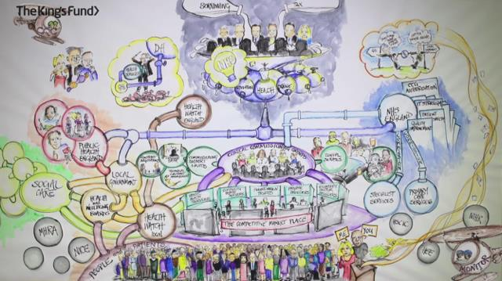
The Current NHS Landscape
Future

