Slide 1
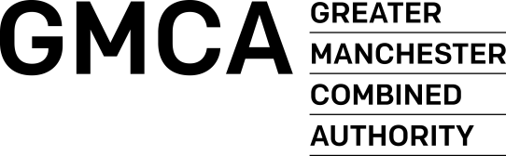


Integrated Care Workforce Showcase Event Nov 2015
Yvonne Rogers – Strategic HR/Workforce Lead

Slide 2
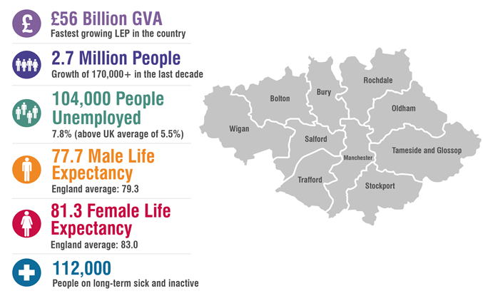
Greater Manchester: a snapshot picture
GVA – Gross Value Added
LEP – Local Enterprise Partnership

Slide 3
The background to GM Devolution
Greater Manchester Devolution Agreement settled with Government in November 2014, building on GM Strategy development.
Powers over areas such as transport, planning and housing – and a new elected mayor.
Ambition for £22 billion handed to GM.
MoU Health and Social Care devolution signed February 2015: NHS England plus the 10 GM councils, 12 Clinical Commissioning Groups and NHS and Foundation Trusts
MoU covers acute care, primary care, community services, mental health services, social care and public health.
To take control of estimated budget of £6 billion each year from April 2016.
Commitment in July 2015 budget to align the Spending Review process for health and social care to our Strategic Sustainability Plan
From Oct 1st 2015 a new shadow Governance structure in place.

Slide 4
What will – and won’t - this mean for the NHS and social care
Greater Manchester will remain within the NHS and social care systems and continue to uphold standards in national guidance and statutory duties in NHS Constitution and Mandate – and for delivery of social care and public health services
Decisions will continue to be made at the most appropriate level to the benefit of people in GM – sometimes locally and sometimes at a GM level
Organisations will work together to take decisions based on prioritising their people and their place
From 1 April 2015 ‘all decisions about GM nationally are taken with GM’

Slide 5
What does this mean for the GM Workforce?
Key Workforce Aims of the Devolution Agreement
To ensure the workforce is liberated and flexible
To ensure the workforce will work across both organisational and geographical boundaries
To ensure the workforce is fit for purpose
To ensure the workforce is sufficient and capable of providing high quality care at the point of need
To ensure the workforce embraces the culture and values of devolved health and social care
Notes:
As at March 2015, the healthcare workforce in GM was 64,687 ftes (excluding social care staff and the unpaid workforce)

Slide 6
Notes:
In preparation for the devolution of health and social care budgets in April 2016 each of the 10 local authority areas has set out how they will reform and integrate their local services in a document called a locality plan. Manchester’s locality plan has been informed by years of conversations and engagement with staff and the public about their ideas and learning for integration, prevention and the other big health themes.
The Living Longer Living Better (LLLB) programme underpins the Locality – by bringing all the health and social care providers and commissioners together to quickly tackle the big issues facing our local services such a population living with increasingly complex conditions and needs.

Slide 8
Strategic Plan – our vision- by Dec 15
Overarching plan
Integrated document including detailed financials
Resulting Components of the GM Model
A Social Movement for Change
Evidence Based Care across all Settings
Locality Based ICO/ACO operating a common prospectus
New Hospital Models
Health In novation Manchester
Single Estates Function
Single Workforce Transformation Plan
Single Information Governance and Data Sharing Agreement
Locality plans (10)
Set out local ‘place view’ and key focus on integrated care approach; Consistent format and structure that can be aggregated
Provider Collaboration Plans
Set provider intentions and opportunities of how to deliver better care/productivity linked to estates requirements
GM Workstreams
Set out plans for GM-wide initiatives including provider reform/configuration and key enablers
8
Notes:
We have just received the 10 locality plans outlining how employers/providers aim to deliver the Devolution requirements.
These will now be combined to produce an overarching strategic plan articulating GM intentions and in particular focussing on how to manage the financial gap

Slide 9

Our Ambition
By April 2016 we will take care of our own £6bn funding, and with this money we will make a number of significant investments so that by 2020 we will have…
64,000 less people with chronic conditions
10% less visits to urgent care
6,000 less people being diagnosed with cancer
25,000 people with severe mental illnesses will benefit from better community-based care, reducing need for urgent services by 30%
18,000 children better supported by local services
700,000 people with chronic conditions, better able to manage their own health

Slide 10
Opportunities for the Workforce
Increased opportunity for multi-disciplinary working
Increased opportunity for co-location of staff
Opportunity to engage workforce in co-producing, supporting and implementation of local strategic vision and new models of care
Improved information sharing
Development of generic competencies to support integrated working
Increased skill and capacity across the health & social care workforce
Integrated health & social care workforce strategies, with more examples of joint commissioning
Production of quality standards and best practice frameworks to ensure consistent working practices

Slide 11
Challenges for the Workforce
The transition to integrated care and support
Finding and keeping the right people with the right values
Ensuring the culture fits
Working across traditional role boundaries
Lack of capacity to drive the agenda forward (competing pressure and demands on time/resources)
Difficulties in sharing data across partner organisations
Lack of engagement from key partners across Health, Social Care etc
Duplication across the sectors
Lack of clarity about the new ways of working
Lack of leadership
Notes:
Key challenges:
The shift from a focus on individual episodes, often as part of a hospital team to managing multi-morbidities in communities and people’s homes as part of multi-disciplinary teams
Addressing the mismatches in the locations of the current workforce and where care is needed
Across the medical workforce the NHS is forecasting an oversupply of hospital doctors and an under-supply of GPs
Significant financial pressure in social care, against a backdrop of increased personalisation of services
In social care, the mismatch between supply and demand is forecast to be 1 million workers by 2025 with a greater shortfall in carers
The need to engage the unpaid workforce in addition to the paid workforce – in 2011 there were 5.4 million informal carers in England, which was a rise from 4.9 million in 2001. 1.4 million carers provide over 50 hours of unpaid care work per week, the value of which is estimated to be £119bn per year.

Slide 12
Thank You
Any Questions?

