Slide 1


Slide 2
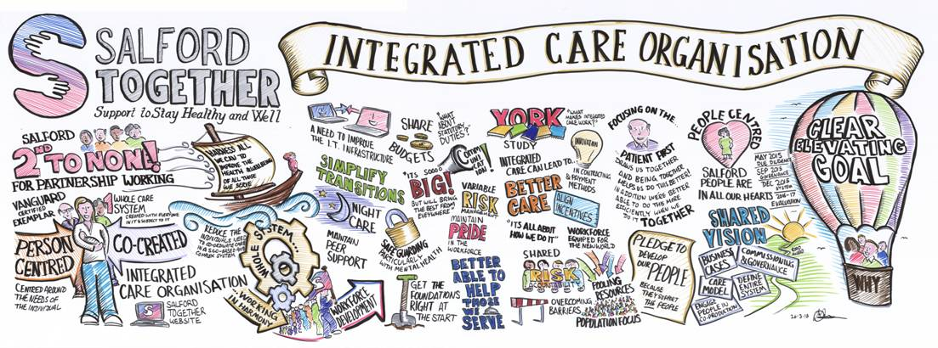

Slide 3


Slide 4
Lessons learned…

Slide 5
What tools could be used to continue to support a workforce to build and maintain the right culture for this journey?

