Slide 1
Integrated Workforce Demonstrator Site –Rochdale
Presentation by
Fiona Nuttall: Transformational Lead (OD), RBC
Catherine Saunders: Occupational Therapist, Intermediate Care, Pennine Care
Carole Greaves: Occupational Therapist, Adult Care, RBC
Notes:
Give a brief overview of the presentation. Describe the major focus of the presentation and why it is important.
Introduce each of the major topics.
To provide a road map for the audience, you can repeat this Overview slide throughout the presentation, highlighting the particular topic you will discuss next.

Slide 2
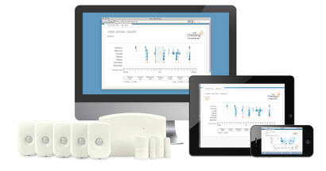
Working together to assess using Just Checking
Activity monitoring systems can help as part of the assessment process. Just Checking is an easy-to-use online activity monitoring system which is used extensively within Adult Care. There are no cameras or microphones, just simple motion detectors that create an easy-to read activity chart which can be viewed quickly and easily through a secure online service. The activity charts can evidence some of the following:
No signs of activity in the morning
A door has been left open
A night time exit
A care visit wasn’t as expected

Slide 3
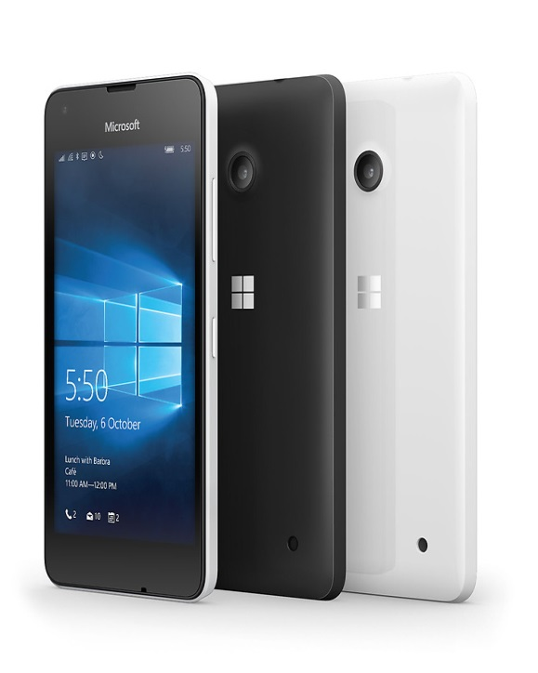

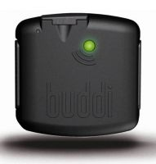
Traditional care > technology
Care Home Buddi GPS Smart phone

Slide 4
Working together to achieve outcomes
Life style monitoring systems are routinely used
Embedding of technology assessment into holistic assessment
Clear processes in place for technology provision
Assistive Technologies are an integral part of hospital discharge
Regular learning sessions, product evaluation and joint training
Positive outcomes for technology users
Reduced carer stess
Reduced costs of care and support
Regular events demonstrating technology jointly with health, carers services, voluntary organisations including involvement with BME Dementia Service

Slide 5

Effective technology : using an integrated approach
Joint holistic assessment
Sharing learning
Positive risk taking
Seamless approach
Creative application
Demystifying
Supportive
Working together

Slide 6

What's next !
Technology champions in each service area
Continually updated information and advice for the public to access
Technology is a key solution in medication compliance and management
Range of apps being used with Smart phones
Use of i care to monitor health and well being
Increasingly sharing information assisting in managing long term health conditions
Pathway for joint assessment where epilepsy sensors are requested

