Slide 1
Integrated Care Workforce Demonstrator site showcase
Connecting Care in Central Cheshire
Integrated Community Teams
Lynda Robinson
Claire Gibbons
Barrie Geeleher

Slide 2
Contents
Background
Creativity in New roles
Complex Case practitioner
Care Facilitator
Future Changes- discussion point

Slide 3
Background
Health, Social and other Care developing more integrated working around GP clusters
Integrated localised approach aims to:
Improve quality of service
Reduce number of unplanned admissions
Decrease length of stay
Prevent admission to hospital/long term care
Support people’s recovery and independence in community

Slide 4
Background - Partners
Partners include:
GP’s central Cheshire
Cheshire West and Chester council
Cheshire East council
East Cheshire NHS Trust
Mid Cheshire Hospitals NHS Foundation Trust
Cheshire and Wirral partnership NHS Foundation Trust
NHS Vale Royal and South Cheshire Clinical Commissioning Group’s

Slide 5
Background cont.
Change in the way of working to meet needs of population in central Cheshire
Building on joint working
Workforce Model
Pump priming investment
New roles
Integrated ‘true ‘ team
Single access to resources/referral/assessment
Streamlining co-ordination of care
Proactive and preventative case management

Slide 6
Integrated Team
Core (GP cluster specific):
Locality specific
(multiple GP clusters)
District Nurse
Care Facilitator
Patient
Complex Case
practitioner
Social Worker
Social Care Assessor
GP
Community Matron
Community Geriatrician
Mental Health Practitioners
Physio/OT’s/SALT/
Dietician
GP
GP
GP
GP

Slide 7
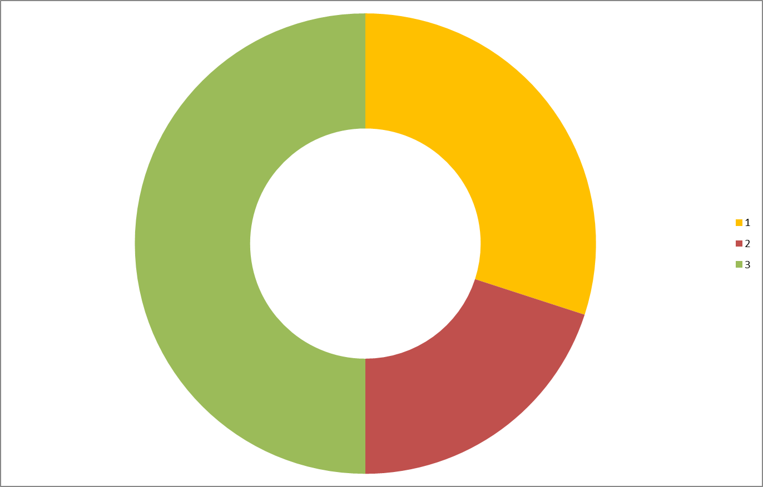
Patient centric
PROACTIVE
REACTIVE
Supportive Care in Community
Rapid Response Community Care
Integrated Care Teams Locally Situated
Rapid Assessment
Nurses, GP, Physio, SW, OT, Mental Health, Care Co-ordinator
Rapid Care in Community or Care Home
People
Access system at any point
One assessment
GP Remains Involved
Third Sector Providers
Specialist Services (SALT, Dietician, TVN, Diabetes
Care Plans in Place
Care Needs established for Most Frail
Hospital Care
MDTs to Support Team Approach
Rapid Discharge
Easy Access to Information
Information Transferred
Support Network of Person Known

Slide 8
Creativity in New roles- Complex Case Practitioner
Patients currently fragmented Care package
Likely co-morbidities
Multiple poly –pharmacy
Currently coping
?

Slide 9
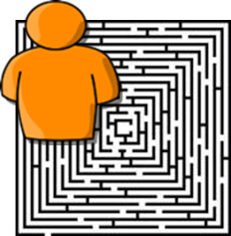
Complex Case practitioner
Seek out complex cases
Risk stratification
Including indicators social isolation/rurality
Using knowledge of health, social and other care services
Advanced diagnostic skills
Understanding of range of problems and how they interact to create a risk situation

Slide 10
Complex Care Practitioner
Direct local support services
Monitor and optimise their independence and self-care
PREVENTION AND PROACTIVE CARE CO-ORDINATION

Slide 11
Proactive Case Management
The individual patient can expect:-
A single assessment (tell the story once)
More holistic assessment and timely response
Increase in appropriate timely intervention (proactively sought and invited in)
Care in the right place with the right professionals
Reduce unplanned care and crisis
Reduction in GP home visits

Slide 12
Proactive Case Management
Growing and developing our staff to:-
Work within multi-disciplinary teams
Provide holistic assessments & case management (potentially crossing traditional professional boundaries)
Deliver “empowered patient” programmes
Effectively sign post to and use voluntary sector services
Teams to be established by April 2016

Slide 13
Care Facilitator
Facilitate MDT
Support Risk stratification in absence of perfect Information systems
Facilitating conversations between Health and Social Care
Wealth of knowledge of Health, Social and other care services

Slide 14
Care Facilitator
Receive admission information for each cluster
Initiate admission conversations within the Health and Social team
Alert Care co-ordinator to prospective discharge and support allocation to Care co-ordination

Slide 15
Discussion point
Difficulty in embedding new roles:
Practical and cultural aspects
Future Changes

