Slide 1





Wellbeing
Ward & Community Volunteers

Slide 2
Two Partners
Wellbeing Enterprises CIC
Halton & St Helens VCA
Their mission is to support individuals and communities to achieve better health and wellbeing.
They do this by
educating the general public
unlocking the assets within their communities and
working collaboratively with their partners to tackle the underlying causes of poor health.
Has a vision of a strong voluntary and community sector that is dynamic, responsive, diverse and improves the quality of life for local people and communities.

Slide 3
Why Wellbeing Matters
Improving wellbeing has been shown to help save lives and money. It is a worthwhile goal in itself, and leads to better outcomes:
reduces prevalence of mental illness
physical health: mortality/morbidity
health behaviour
employability, productivity and earnings
educational performance
crime / violence reduction
pro-social behaviour/social integration / relationships
quality of life
Friedli (2009) Mental Health, resilience and inequalities

Slide 4
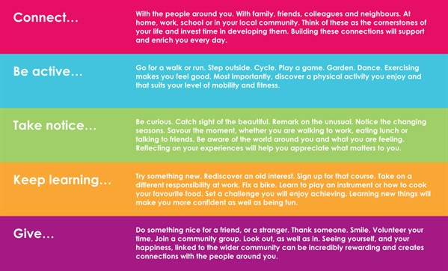
Five Ways To Wellbeing

Slide 5
Identified Problems
Lengthy hospital discharge delays
High re-admission rates

Slide 6
The Project
Pilot the use of Volunteers in hospital wards and in community settings to determine whether a Volunteering scheme can:
Improve the patient experience of care from wards transferring into the community
To expedite the discharge process and improve flow in hospital wards
To reduce the rates of readmissions over a defined time period.
Notes:
Central to the model is the mobilisation of a team of appropriately trained and co-ordinated Community Volunteers who will provide informal social support, complementing the work of paid staff. It is anticipated that volunteers will perform roles essential to the successful return and stable long-term re-settlement of patients, including low level, practical support for a time limited period. They do not provide any clinical services or personal care, but omplement any other health or social care services provided at home. Community Wellbeing Volunteers – this would tie in with our existing volunteer programme which is currently funded by the National Association of Primary Care

Slide 7
Volunteers
There are two Volunteer roles:
1. Ward Wellbeing Volunteers - based in hospital wards
2. Community Wellbeing Volunteers – community based, undertaking home visits*.
*Initial visits carried out with a WE employed Community Wellbeing Officer
Notes:
Ward Wellbeing volunteer – who have a presence on the wards: interact with patients and carry out wellbeing brief interventions, provide social contact and practical support.
Community Welbeing volunteer – who work in the community and go on visits with paid Community Wellbeing Staff and then continue face to face contact with patients after paid staff interventions have finished. Paid staff maintain telephone contact at set times frames to monitor

Slide 8
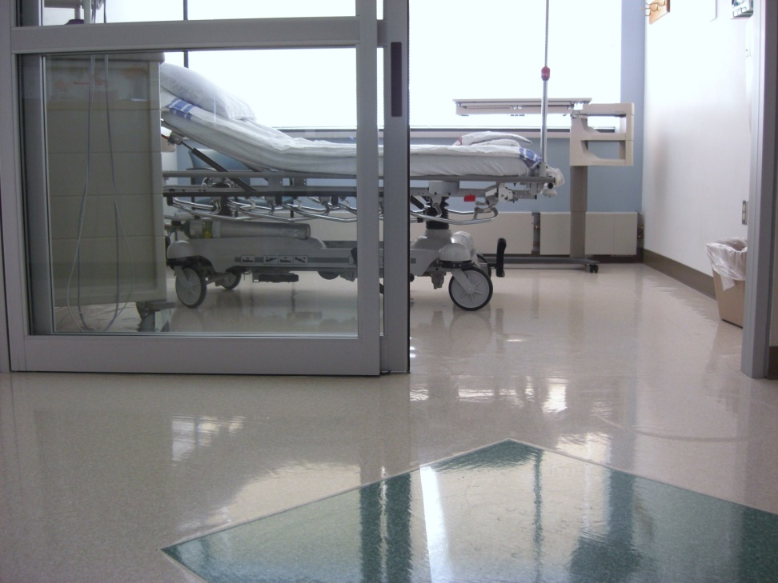
Ward Volunteer
Provide social support
  offer an listening ear
  being there a someone to talk to
  offer top tips for them to improve their wellbeing
  general socialising e.g. chatting, puzzles, reading
Provide practical support
  Make a hot drink/offer a glass of water
  Bring to chapel, gardens or library
  Shopping e.g. snack, drinks
  Support to obtain discharge letters/medication
  Checking their home is suitable for their return

Slide 9
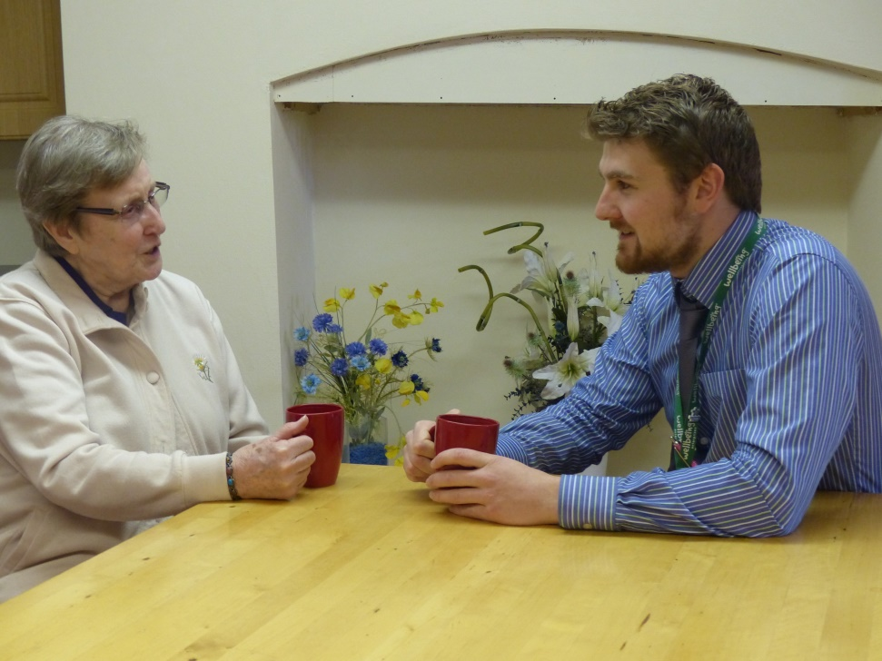
Community Volunteer
Provide social support
  offer an listening ear
  being there a someone to talk to
  offer top tips for them to improve their wellbeing
  general socialising e.g. chatting, puzzles, reading
Provide practical support
  Make a hot drink/offer a glass of water
  Bring for a walk
  Refer to partner organisations
  Shopping e.g. snack, drinks
  Deal with small household chores e.g. making bed

Slide 10
Support
Before discharge – on the ward
On The Day Of Discharge – short term “welcome home”
Post Discharge – “staying home”
Notes:
within the ward setting, the volunteers would help aid recovery by offering the general support that a busy Nurse or health practitioner finds it difficult to deliver, i.e. regular drinks, reading, crosswords etc. The evidence based 5 ways to well being are not always practiced within the ward setting, our volunteers will be trained in the 5 ways and able to implement very quickly . Providing evidence based wellbeing messages that are aimed to build confidence, self efficacy and tackle social isolation that may exacerbate underlying medical problems.

Slide 11
Patients Supported
Halton residents
Aged 65+

Slide 12
Outcomes
A developed volunteering programme with underpinning volunteer management training
40 volunteers recruited
100 patients supported
Working across two acute trust sites

Slide 13
The Journey So Far
Started in April
Roles, recruitment process, management, training and support mapped
Volunteering management training delivered
Recruitment drive - 63 expressed an interest in volunteering
22 volunteers inducted
2 acute trusts engaged

Slide 14
Risks and Mitigating Factors
There have been a number of challenges that have presented during the length of the scheme:
Seeking senior buy in from the hospital trusts
Aligning our volunteer programme with the trusts induction programmes
The length of time it takes to complete the hospital induction programme and subsequent red-tape
The recruitment and continued engagement of volunteers in the programme

