Slide 1
HENW Integrated Care Workforce Demonstrator Site Showcase Event Elizabeth Bradbury, Director
3rd November 2015

Slide 2
Aims
To consider the integrated health and care workforce
Partnerships
Capability
Spreading and adopting new ways of working

Slide 3
About AQuA
Established in 2010 as a NHS health and care quality improvement organisation. Based in North West England
Members: 73 commissioner and provider organisations
Hosted by Salford Royal Foundation Trust and accountable to
AQuA’s Board
AQuA members through membership agreements
Extensive work on integration and transformation
https://www.aquanw.nhs.uk

Slide 4
Industrial age medicine
Information age healthcare
Infectious diseases
Hospitals predominate
Acute intervention
Silo working
Paper based
Doctor knows best
Chronic diseases
Community based services
Prevention and self care
Integrated delivery network
Smart use of technology
Shared Decision Making

Slide 5
AQuA’s system integration framework
Service and Care Model Design
Leadership
Workforce
Role design
Skills
Capacity
Integration to Improve
Safety
Experience
Effectiveness
Population health
Use of resources
Service User and Carer Engagement
Information and Information Technology
Healthcare value
Governance
Financial and Contractual Mechanisms
Culture

Slide 6
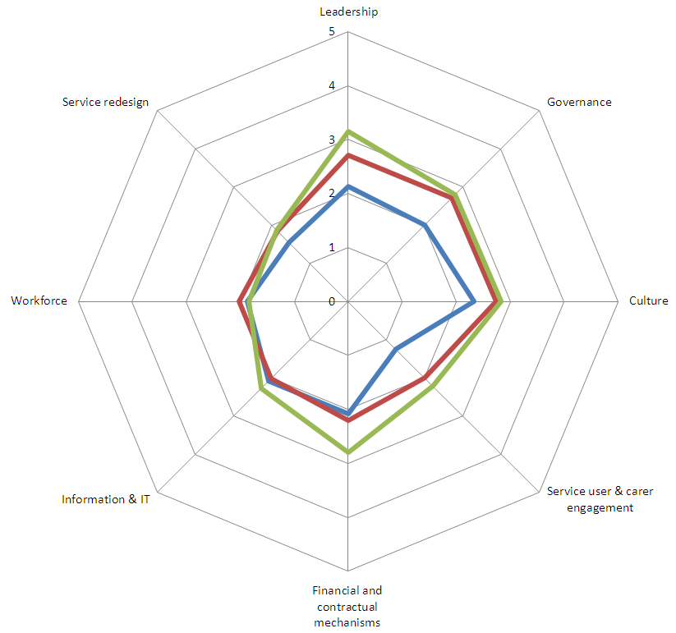

Slide 7
Frame the options

Slide 8
“The first step toward systematic improvement is to intend it.”
Source: Don Berwick

Slide 9
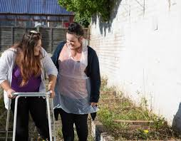
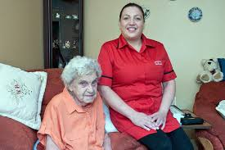
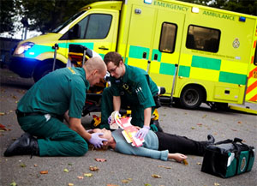
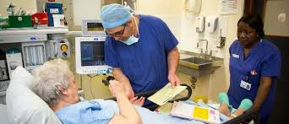
Who will we care for?

Slide 10
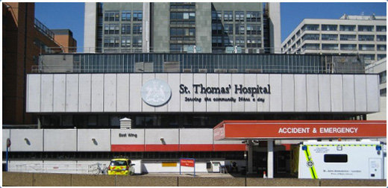
Where will we work?

Slide 11
Who will we work with?

Slide 12
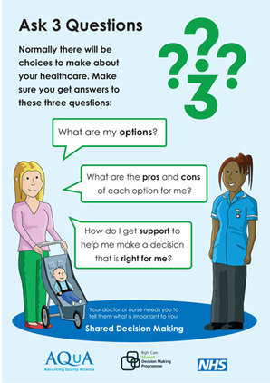
Partner with service users
“You have to help me treat myself. I need to have control in my life.”
Christian Farman. www.ihi.org
Self management coach rather than technical expert
Access to shared information
Online access and consultations
Shared approach to risk

Slide 13
Partnership working
Co-ownership
Joint responsibility
Collaboration
Working together
Co-ordination
Avoid duplication & confrontation
Co-operation
Help when can
Co-existence
Maintain own territory
Source: Adapted from Cowan Global
Maturity

Slide 14
Build workforce capability to support transformation
Quality improvement
Change management
System leadership
Technical
Berwick (2013) and Keogh (2013)
Build workforce improvement capability at four levels
Train individuals and teams from front line to the Board

Slide 15
AQuA’s model of spread
Evidence and Intelligence
Robust Improvement Methods
Incentives
Change Champions and Communities of Practice
Peer to Peer Learning

Slide 16
Diffusion of innovation
2.5%
13.5%
34%
34%
16%
Early
Adopters
Early
Majority
Late
Majority
Innovators
Laggards
Source: Everett Rogers, Diffusion of Innovation

Slide 17
Attributes of the change
Relative advantage compared to current
Compatibility with current system & values
Simplicity of change and transition
Trialability - how easy is it to test?
Observability of change and its impact
Source: Everett Rogers, Diffusion of Innovation

Slide 18
“Never doubt that a small group of thoughtful committed citizens can change the world; indeed, it’s the only thing that ever has.”
Source: Margaret Mead, anthropologist

Slide 19
Thank you elizabeth.bradbury@srft.nhs.uk
www.aquanw.nhs.uk AQuA@srft.nhs.uk

Slide 20
Of interest…
http://www.kingsfund.org.uk/sites/files/kf/field/field_publication_file/perspectives-nhs-social-care-workforce-jul13.pdf
Download the Ask 3 Questions leaflet:
http://www.aquanw.nhs.uk/Downloads/SDM/AQ3/Ask%203%20Questions%20Leaflet.pdf
AQuA Integrated Care Domain Guides (workforce section starts slide 36)
https://www.aquanw.nhs.uk/Downloads/Integrated%20care/Domain%20Guides%20and%20Supporting%20Information%20Final%20April%202015.pdf

Slide 21
Patient Perspectives
Renal dialysis in Ryhov County Hospital, Sweden
ttps://www.youtube.com/watch?v=VEk-A3k98QA
Home dialysis in England
http://www.kidney.org.uk/help-and-information/videos/empowering-kidney-patients-through-self-care/

