Slide 1
BETTER CARE TOGETHER
ADDRESSING OUR KEY WORKFORCE CHALLENGES
David Wilkinson
Director of Workforce & OD
University Hospitals of Morecambe Bay
NHS Foundation Trust

Slide 2
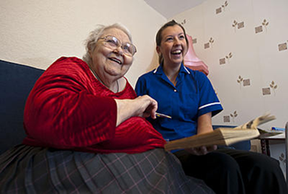

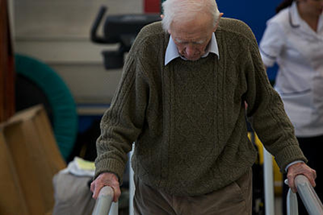
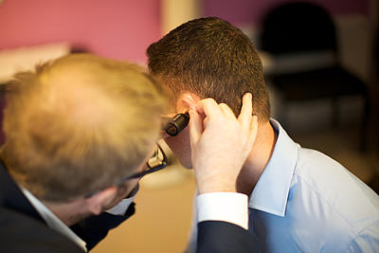
Background
Better Care Together is the clinical strategy for health care across the Bay that features:
population-health approach
creation of innovative ways to deliver care
partnerships in an Accountable Care System
high levels of clinical and stakeholder engagement in designing needs-led systems

Slide 3
Why do we need Better Care Together?
Services haven’t been to an acceptable standard
Morecambe Bay
  Twice the average area
  Twice as many sites to a below ‘average’ population number
  On-going financial gap of £26m rising to £71m in 5 years
  We have a shortages of key professionals
Health professional to health professional communication could be better
Patients and the public tell us its difficult to know who provides what in our “integrated” system
Good IT but scope to work much smarter and improve, e.g. patient records and appointments, telemedicine

Slide 4
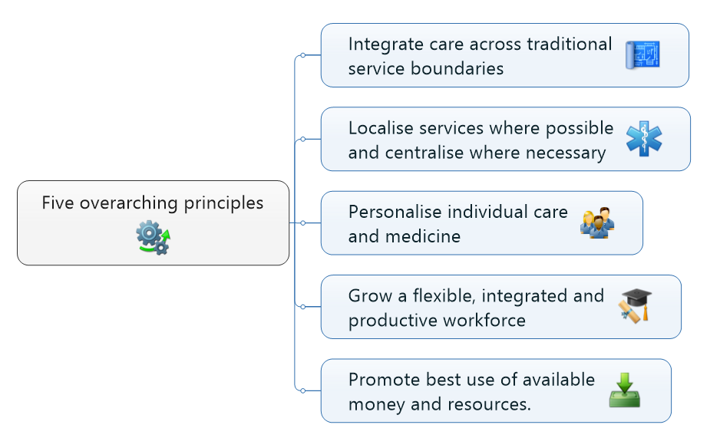
An Accountable Care System
BCT sets out the significant ambition to implement a new, modern clinical strategy that will lead to improvements in outcomes, more efficient delivery of care and better patient experience.
Our vision is to transform the care provided, creating a seamless experience for the patient, whether they receive care in the home, community or in hospital: a vision for safe, high quality and sustainable services into the future.
The Vanguard Value Proposition is based on accelerating the delivery of the BCT Strategy and going much further than the original scope of the programme to develop a truly integrated Accountable Care System with a population health focus and mobilised communities.
The development of a Memorandum of Understanding of the possible network is being facilitated by Prof Chris Hams
Five overarching principles underpin BCT’s vision for a sustainable health and social care system that provides the best care possible.
This can be summarised briefly as follows:

Slide 5

Better Care Together Partners
North Lancashire Medical Services South Cumbria Primary Care Collaborative
GP Federations

Slide 6
The journey so far……
Integrated care communities piloted in Garstang: wrap around care from all health and care services for people with complex conditions
Award winning population-health approach in Millom with community and health partners working together
Focus on self-care and wellbeing in Carnforth
Improvements to planned care pathways in development
Developing a co-ordinated approach to urgent care with our community services
New initiatives for women's and children's services e.g. improving pathways of care for children

Slide 7
Workforce Challenges
Strategic Level
Engagement
Common language
Baselining
Visioning the new workforce
Operational Level
Gathering, collating and interpreting workforce data
“Outreach” v “Inreach” workforce support
Recruitment and Retention
Notes:
I have added R & R to the challenges highlighted by Robert – but should this also include broader challenges:
Organisations working together
Engagement with staff
Engagement with staff side
Differing boundaries of organsitions – those part in BCT
Different structures of workforce support across organisations

Slide 8
Workforce Collaboration
3 key areas
Workforce Planning
Recruitment & Retention
Improvement & Learning

Slide 9
Workforce Planning
Collating current workforce plans - assessing baselines, establishments, fill rates and demand growth, cross-referenced with newly qualified demand and narrative submission
Better Care Together in theory, not practice
Little joined-up working
2-D thinking

Slide 10
Leading Change through WRaPT
“Light touch” WRaPT sessions
Shift to an “inreach” workforce support model
Baseline plans
Workforce scenarios
Workforce Planning narrative at workstream level

Slide 11

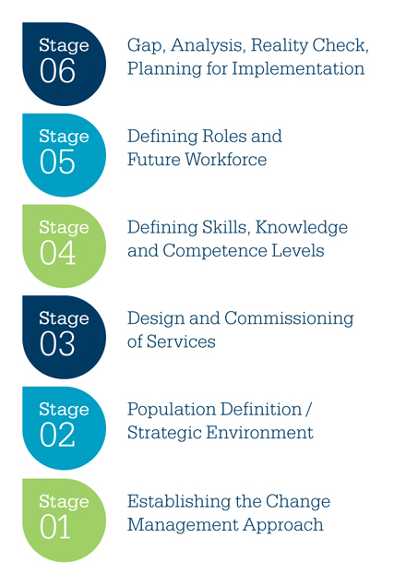
Strategic framework to planning: Population Centric™ approach

Slide 12
Specialist v Generic
Service element | Competence level
SKILLS/KNOWLEDGE REQUIRED | Spe % | Int% | Bas %
Taking Blood Pressure |  | 5 | 95
History taking and diagnosis | 5 | 95
Assessment of home environment |  | 95 | 5
Daily Living Skills |  |  | 100
Prescribing medication | 95 | 5

Slide 13
Recruitment & Retention
Key Strategic Risk
  Individual organisations very challenged
  BCT programme – future workforce
Better Care Together Recruitment and Retention Strategy
Virtual Recruitment Hub
Notes:
R & R – key strategic risk
Current challenges
Future workforce
The recruitment and retention of a high calibre workforce is essential to achieving the BCT vision for health and care services across Morecambe Bay. However, it is recognised that recruitment and retention is an ongoing issue for all of our BCT health and care organisations, particularly in relation to roles where there are local / national shortages and specialist roles. It was therefore agreed by the BCT Workforce Group at their first meeting in December 2014 to develop a recruitment & retention strategy for the ‘bay’.
BCT Recruitment & Retention Strategy agreed at Programme Board – July. Developed together with leads from each main provider organsition.
‘

Slide 14

Better Care Together Recruitment and Retention Strategy
Our Purpose
Our Promises
Our Journey
To ensure the provision of safe, integrated healthcare and high quality clinical services across heath and care in Morecambe Bay
To work collaboratively to recruit and retain a talented workforce
To ensure stability of services during periods of significant workforce change
To enable the transition to increased services out of hospital
To minimise the risks of vacancies, including in hard to fill areas
Our Goal is
to have the right staff, with the right skills, in the right place, at the right time to provide safe, integrated and high quality clinical services to our population.
INNOVATE
-New roles, new career pathways
-Engage together with our local communities and education partners- Inspiring Youth, recruitment, development, ‘Grow our Own’
-Collaborations to attract and retain talent to work in Morecambe Bay
Shared Learning events
LEAD
-Virtual Recruitment Hub
Recruit and induct into the System – Better Care Together umbrella branding
Collaborative retention strategy
Shared communications
Leadership development
ENABLE
-Workforce planning across the system
Collaborative recruitment and retention activity and planning
Values based recruitment
SHARED VISION…
We will recruit high quality staff, with the right skills and
values, into the Better Care Together System to meet
the needs of our local population
ATTRACT…
We will work together to attract staff locally, nationally and internationally
FLEXIBLE AND DIVERSE...
We will recruit and develop staff who can grow
to meet future workforce and population needs
Supporting system shift
TALENT...
We will retain talent. Talent management and
development opportunities across Morecambe Bay
Safe, quality care
Great opportunities to develop
CREATE…
New roles, new ways of working, innovative solutions
A unique opportunity
An exciting time to join
Notes:
Approved at Programme Board July 2015. Developed together with leads from each main provider organisation
plan on a page’ suggests the development of a Virtual Recruitment Hub across all of our BCT partner organisations to:
Provide collective advice, assurance and prioritisation on recruitment and retention activities to the mutual benefit of the whole system
Ensure stability amongst all of our new & existing services
Drawn from:
Existing HR/workforce resource within each of BCT’s provider & social care organisations
Nominated workforce leads where formal HR/workforce resource isn’t in place e.g. within CCGs; emerging GP federations & third sector providers
The ‘hub’ focuses specifically on:
Attraction
Recruiting into the BCT system under an umbrella ‘BCT brand’
Engagement with local communities and recruitment markets
Engagement with recruitment markets in the wider UK and internationally
Retention
Organisational development
Employee growth strategies
Collaborative responses to factors affecting retention
Workforce flexibility
Pay and reward
Early days - Work to date includes:
Establishment of group and membership
Agreement of proposition for the group
Starting to bid jointly for HENW schemes, eg RTP, Pre degree year of experience, career and engagement hub
Joint review of hard to fill areas and initial areas of focus
Starting to develop options for a single point of access for roles in the locality

Slide 15
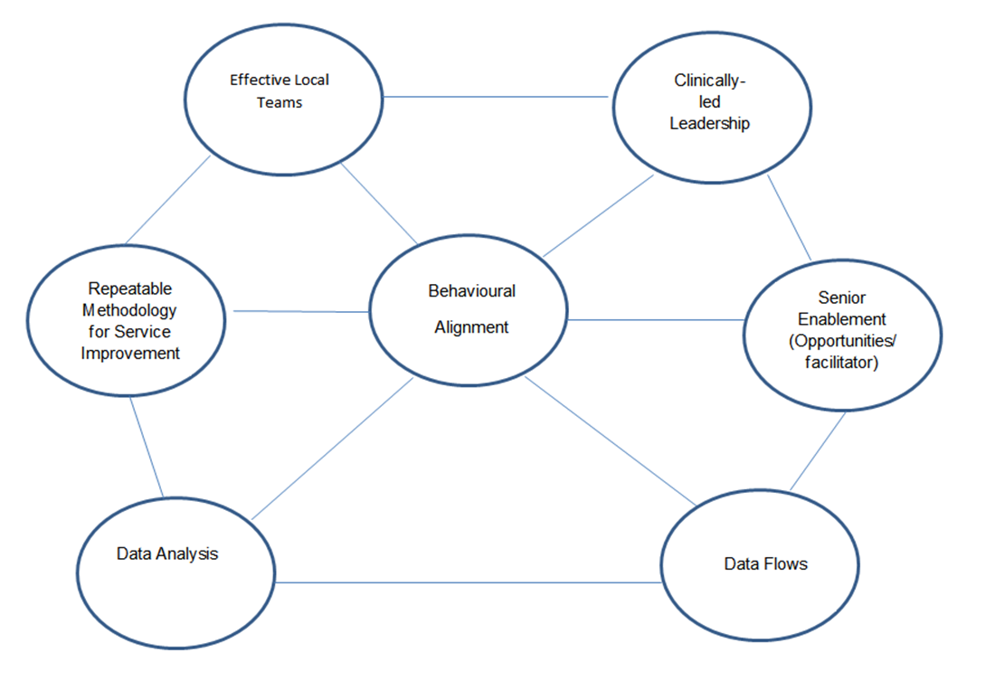
Improvement & Learning
Richard Bohmer, King’s Fund, 7 Elements to Transforming Organisations

Slide 16
Next Steps
Learning & Innovation Hub
  Improvement Engine
  Learning & Sharing Best Practice
  Cultural Driver
  Leadership Development
Engagement
  Beyond LiA
  Staffside Infrastructure

