Slide 1

Workshop 3:
Care home support initiatives: Driving up quality in care homes
By Vicky Webster & Dawn Clarke
Notes:
Overview of the project: background of integrated care demonstrator site

Slide 2
Background: Culture
‘The NHS belongs to the people… It touches our lives at times of basic human need, when care and compassion are what matter most.’
- The NHS Constitution
‘The system as a whole failed in its most essential duty – to protect patients from unacceptable risks of harm and from unacceptable, and in some cases inhumane, treatment that should never be tolerated in any hospital.’
- Robert Francis QC
‘This Public Inquiry not only repeats earlier findings but also shows wider systemic failings so I would like to go further as Prime Minister and apologise to the families of all those who have suffered for the way that the system allowed such horrific abuse to go unchecked and unchallenged for so long. On behalf of the government – and indeed our country – I am truly sorry.’
- The Rt Hon David Cameron MP
Notes:
Overview of the project: background of integrated care demonstrator site
In recent years, a number of reports have been published that have cast the spotlight on the quality of care patients have experienced. More often than not these reports have been negative and have highlighted failings in our systems, many of which can be attributed to the culture of care in organisations.
These reports do not make comfortable reading and, in the majority of cases, the failings and the negative impact on patients and staff could have been prevented. The lack of a consistent culture of care and compassion can impede the spread of good practice across organisations and result in devastating experiences for patients, their loved ones and the staff caring for them.

Slide 3
Workshop: Culture
Why care about culture?
  We can not make sustainable improvements if people do not engage and the culture is poor!
    Lessons learned – Winterbourne, Francis, Kirkup, etc.
    More recently – Hard Truths, the Journey to Putting Patients First
  We must work together to prevent another!
Notes:
Overview of the project: background of integrated care demonstrator site
Culture eats strategy for breakfast
QSGs

Slide 4

What is culture of care?
The aim of the ‘culture of care’ barometer is to ensure:
Staff can provide good care to patients
Patients have a good experience of their care episode
Staff feel valued and satisfied that they are able to raise their concerns when necessary
Notes:
Overview of the project: background of integrated care demonstrator site
Design of the Culture of Care Barometer
The elements underpinning the design of the tool reflect themes identified from previous research as strongly linked with staff commitment, engagement and productivity.
These were:
• the resources to deliver quality care
• the support needed to do a good job
• a worthwhile job that offers the chance to develop
• the opportunity to improve team working

Slide 5
Workshop: Culture
Beliefs and values lead to actions that create a positive care culture
Positive care culture enables norms and assumptions of care practice
Norms of care practice reinforce beliefs, values and actions
Developing a positive care culture.
The features of a positive care culture are interconnected and help to facilitate and reinforce each other.
Notes:
Overview of the project: background of integrated care demonstrator site

Slide 6
Workshop: Culture
  Care home support initiatives
  How does cultural change need to be managed to support the successful implementation of such an initiative?
  Culture is focusing on targets, activities, resources, needs, features, organisational values, etc. that define the identity of their organisation, their role or their service.
  Key aim: To improve patient care
  Added benefits:
  To reduce non-elective activity in admissions of older people / people with long term conditions to hospital
  To improve staff morale
Notes:
Overview of the project: background of integrated care demonstrator site

Slide 7
Workshop: Culture
What did we find?
CQC reports ‘require improvements’
Safeguarding alerts
Leadership – lack of
Recognition that we had people doing a good job
Evidence of difficulty recruiting and retaining good nurses
Lack of standardisation in the quality of care
Closure of one care home
Notes:
Overview of the project: Details of the product, process or learning gained from the demonstrator

Slide 8
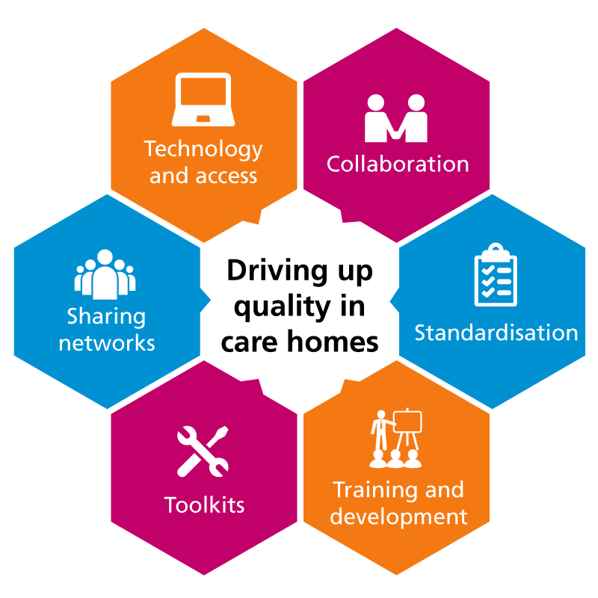
Care home support initiatives
Notes:
Overview of the project: Details of the product, process or learning gained from the demonstrator

Slide 9
Progress to date
Collaboration
  Care Home Quality Collaborative – a task and finish group with multi-agency and multi-disciplinary membership, working together to agree quality measures, initiatives and joint improvements
Notes:
Overview of the project: Key outcomes including metric improvements

Slide 10
Progress to date
Standardisation
  Development of research-based recommendations to drive quality improvements
  Increase of business intelligence tools to inform future developments and standardisation
  Joint quality assurance framework
  KPIs being discussed relating to the quality schedule
  Alignment with regional activity
Notes:
Overview of the project: Key outcomes including metric improvements
Independent sector

Slide 11
Progress to date
Training and development
  Online training solutions
  Training implementation on the priority areas of dehydration and nutrition, pressure area care, falls prevention, MCA / DOLS
  Scoping of revalidation needs amongst care home nurses
Notes:
Overview of the project: Key outcomes including metric improvements

Slide 12
Progress to date
Toolkits
  Care bundles being developed featuring tools and planning packs on a range of areas, including falls prevention, pressure sores and medicines management
  Phased roll out of ‘hydration tool’ to all care homes
  Standard operating procedures for record keeping, safeguarding, professional accountability and incident reporting
Notes:
Overview of the project: Key outcomes including metric improvements

Slide 13
Progress to date
Sharing networks
  Forum for advanced nurse practitioners
  Sharing of best practice and lessons learned
  Local health and care economy ‘Resilience in the Care Home Sector’ conference
Notes:
Overview of the project: Key outcomes including metric improvements

Slide 14
Progress to date
Technology and access
  Tablets in care homes to enable them to link more closely to GPs
  Online reporting and feedback mechanisms for care homes, where their feedback can come directly into commissioners
  Online sharing and collaboration network for care home staff
Notes:
Overview of the project: Key outcomes including metric improvements

Slide 15
The benefits
Benefits to date:
New relationships
Better collaboration
Agreed vision and principles
Common goals and mutual benefits identified
Sharing and learning networks
Anticipated benefits:
Upskilling opportunities
A more educated workforce

Slide 16
Impact across the health economy
Urgent care transformation programme
  Step up, step down
  Ambulatory care
  Integrated neighbourhood teams
  Outcomes
  Reduction in hospital admissions for over 65s
  Reduction in delayed transfers of care
  Increase in in number of people > 65 who are at home 91 days after discharge
  Softer intelligence for quality and performance monitoring
  * Data validation of achievement is currently outstanding
Notes:
Overview of the project: Key outcomes including metric improvements
The metrics are impacted by multiple factors, and the direct influence of better quality in, and integration with, the care home sector, will only be able to be seen longer term. It is not possible to break down the metrics specifically for patients in care homes.
Evaluation of the Project
Achievements to date:
Set up of collaboration networks
Establishment of technological access improvements
Enhanced relationships across the board
Step up, step down – increase in provision and utilisation of beds (34 more actual beds, and 28 more virtual beds, providing a total of 106 actual and 143 virtual)
Ambulatory care – reduction in non-elective admissions of 12% for patients suffering from COPD (to June 15 – awaiting further data)
INT – reduction of multiple admissions for over 75s and admissions for patients with long term conditions – awaiting data

Slide 17
Project evaluation
Feedback from care home staff indicates that they are already feeling more involved as a key and instrumental part of the local health and care economy.
‘Our engagement with, and support from the CCGs was positive.’
- Care home staff, 2015
‘The development areas, such as communications systems and information show that this project is on track to deliver the solutions that the sector wants and needs.’
- Care home staff, 2015

Slide 18
Testimonials
The care home quality collaborative
Good discussion from different perspectives
Shared decision-making
Focused and well-led
Opportunity to standardise across the local care home economy
True collaborative working with multi-agency colleagues
Notes:
Overview of the project: Key outcomes including metric improvements

Slide 19
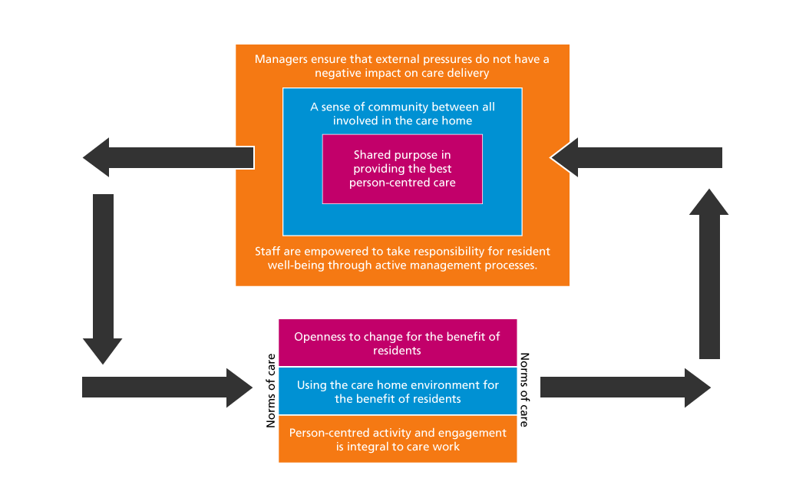
Culture and care
Dr Anne Killett

Slide 20

Workshop: Culture
What is the culture like in care homes?
How do the following aspects impact on culture:
Resources
Support
Development opportunities
Team working / dynamics
Values and beliefs
Board / proprietors awareness
How do you think we can improve culture in our care homes?
Notes:
Overview of the project: Setting the scene for the discussion element
Facilitate a group discussion for developing an integrated care workforce toolkit – how does culture resonate with the challenges and outputs of our project?
Workshop
Flip chart
Ketso
Flip Chart

Slide 21
Thank you!
Any questions?

