Slide 1
Coaching model for Person Centred Care “Person to Partner model”

Slide 2
What is this project about?
Coaching
Co-production
Better health outcomes

Slide 3
What do we want to achieve by when?
Aim:
Jointly develop and test a model for integrated care teams to use when working with patients and their carers as partners in care
Objectives:
Understand what research is available on the impact on health outcomes of using a coaching style approach (literature review)
Jointly develop a coaching model for person centred care
Pilot the evolving model and integrate the learning into a final model
Produce a training needs analysis for professionals based on the agreed model
Evaluate the learning from using the process of co-production and piloting of the model itself
Timescales:
April 2015 – Sep 2015

Slide 4
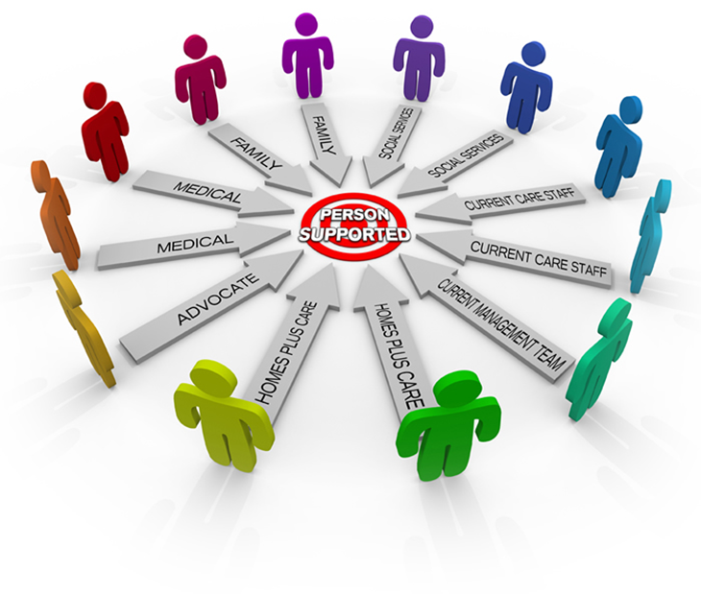
How did we do that?
Session 1 (July): Why? Ongoing engagement throughout the project
Session 2 (Sep): How?
3) Reviewing progress and agreeing success measures
4) Learning\refreshing new way of working based on that
5) Planning how we test this way of working
Session 3 (Oct): What next?
6) Reviewing what we have learned
7) Agreeing what needs to change\stay the same about the approach
8) Planning how to share this learning more widely and influence the development of ONE team across Manchester
1) Understanding why we are here and what the project was trying to achieve.
2) Developing measures for success
Notes:
Triona

Slide 5
Where are we now?
Literature review completed
Co-production of coaching model complete
Success measures developed, tested and agreed
Three development workshops delivered and one additional training session in the model
Extensive stakeholder engagement across a range of groups and organisations giving input to the final product - model
Completion and sharing of interim learning review across Living Longer Living Better programme (Manchester city wide)
Training tools in production
Evaluation framework agreed with data sharing agreement for self care

Slide 6
Patient to Partner model

Slide 7
Measures for success
 | Strongly agree | Slightly agree | Neither agree nor disagree | Slightly disagree | Strongly disagree
I am listened to and agreed action is taken
I am given information that meets my needs
I feel part of the team
I am sent to the right person to help me if I need support
I am involved in decisions about my care

Slide 8
What have we learned so far?
Co-production
1) process 2) challenges 3) benefits
Team dynamics
roles and responsibilities
”new” dynamic of working in partnership
3) who is “the team”? (role of community and voluntary sector)
Empowerment and responsibility
1) not everyone wants to or is comfortable working in this way
it takes time (a precious commodity)
language (shared) & use of jargon
Notes:
Co-production
- Process – everyone has different definitions and expectations of what co-production means and looks like in practice
Challenges – recruitment of people to work with the project, building of trust that this will be different, working to the simplest common denominator, takes time to deliver a co-produced outcome
- Benefits – increased ownership and understanding of what you are trying to achieve by all parties, more acceptable\likely to be sustained product (model), increased understanding of all parties about what it is like to be in each others’ shoes, improved communication (requires constant review)
Team dynamics
Roles and responsibilities – who takes lead responsibility for the patient\person
Authority and decision making in relation for both staff and patient\service user\client\person are all different
Explicit acknowledgement and involvement of community and voluntary sector as active partner, as well as the person and their carer (if there is one)

Slide 9
What else have we learned?
culture – organisational culture and cultural sensitivity for the people that you are working with
diverse populations and expectations - essential to seek engagement and involvement of each neighbourhood in developing new ways of working to gain the ownership and acceptance of that way of working
the use of coaching principles in their own right will not automatically lead to all people become actively engaged in their care
role of the carer is complex
community and voluntary sector not acknowledged as equal partner
Notes:
Role of the carer is complex
if there isn’t an identified carer involved with that person? Assumptions about the carer role and who that is? Family members (sometimes they don’t want to be), also cultural pressures on carers acknowledging that there is an issue to seek support, multiple people within a family who may take on that role

Slide 10
Potential (workforce) risks moving forward
lack of common governance processes across partner agencies within the team leads to confusion and potential gaps where people may fall down
“Patient to Partner” not everyone wants to be a partner - may want to stay as a patient or the professional prefers to work in a more traditional way
lack of availability of the teams for training and support to work in the new way

Slide 11
Next steps
Finalise the development of the model
Test the impact of the new way of working more widely
Complete evaluation approach and model
Develop and further test training materials
Share the learning with relevant stakeholders at key points of Living Longer Living Better programme

Slide 12
Thank you!
Contact details
E-mail: angela.beacon@manchester.gov.uk
Mobile: 07507 227844

