Slide 1
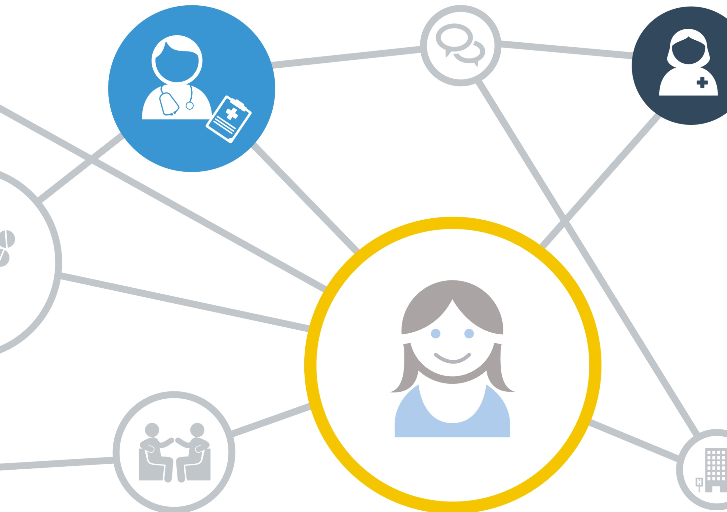




Slide 2

Bolton Context and Background
Bolton Locality within Greater Manchester
one Integrated Care Provider NHS Trust, One Council, co-terminous with the CCG, GMW Mental Health Provider
Better Care Fund submission September2014
Workforce Group integral part of Integration governance framework established July 2014
Demonstrator Site bid Jan 2015

Slide 3
Integrated Care Schemes
Staying Well
Early Intervention and Prevention
Integrated Neighbourhood Teams
Intermediate Care-Bed Based and Home-Based, including Reablement
Complex Lifestyles
Care Home Service

Slide 4
Aims and Objectives
Development of Competency Framework
Development of Educational Resources
Workforce Redesign to meet new service spec requirements
Improvement in Workforce Measures-Staff Family and Friends Test, Appraisal rates, sickness

Slide 5
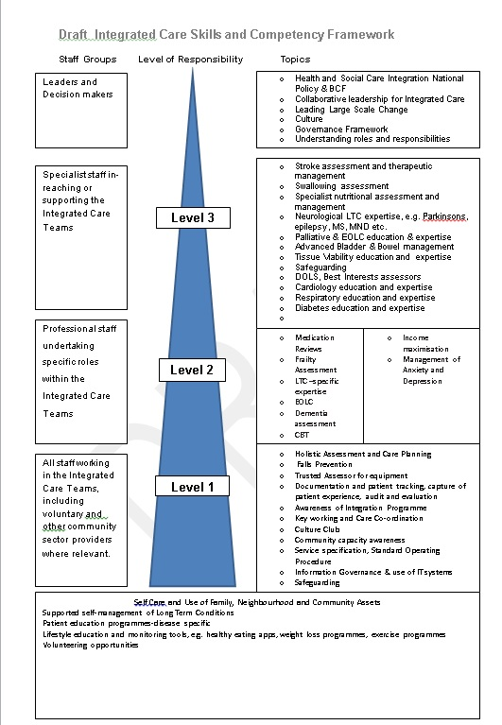

Slide 6
Focus of Today
Staying Well Toolkit
Integrated Neighbourhood Team Toolkit
Culture Club

Slide 7
Staying Well Aim
to systematically identify individuals (age 65 & over) at high risk of future health and social care need and provide advice, support and assistance to enable people to remain healthy, happy and independent for longer.

Slide 8
Asset Based Approach
Promoting maximum independence and self-determination of older people;
Development of community assets/resources
Integration within a whole system of care
Identify support through family, friends and community resources
Mobilising and Empowering communities
Tailoring support to meet the needs of clients through close working with public, private and voluntary services (Innovative change ideas)
Making use of networks and connections in a community
Notes:
balance
• the practical skills, capacity and knowledge of local residents
• the passions and interests of local people that give the energy to change
• the networks and connections in a community
• the effectiveness of local community and voluntary associations
• the resources of public, private and third sector organisations that are available
to support a community
• the physical and economic resources of a place that enhance wellbeing.

Slide 9
Staying Well Team
Team Manager
2 x Team Supervisors
7 x WTE Staying Well Co-ordinators
2 x 0.5 WTE Staying Well Co-ordinators
1 x Project Officer
1 x Community Capacity Lead
Aligned and based within GP Practices/INT

Slide 10
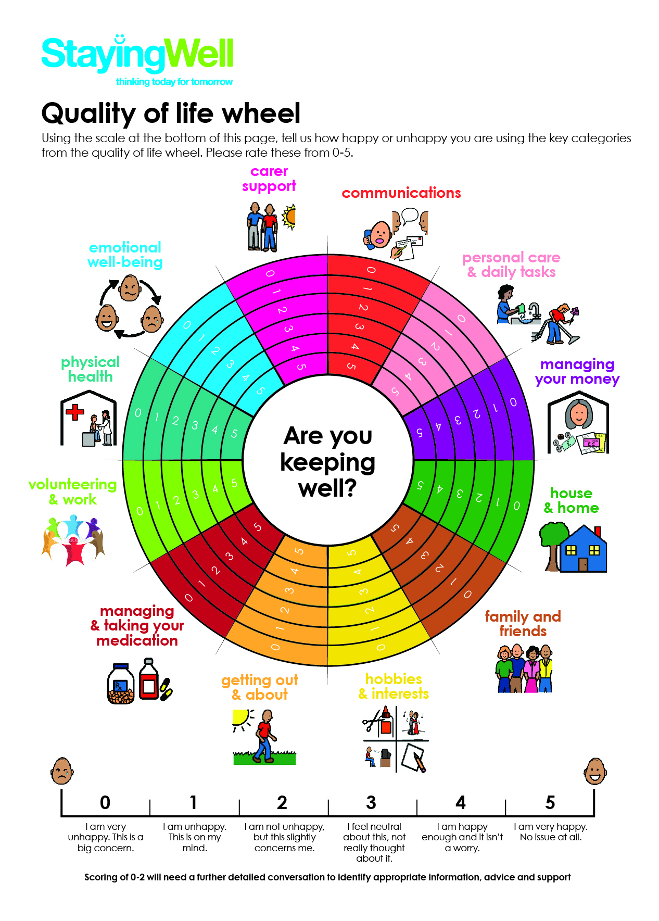
Quality of Life Wheel
12 key themes
Factors & conditions that shapes an individuals health and well being
Quality of Life Wheel Score
Assets as well as needs
Notes:
Major outcome for measurement
Developed by professional and OP themselves
As part of the Staying Well Intervention clients are offered a home visit by their GP Practice.
•A Home visit is carried out by Well-being Co-ordinators using a locally developed standardised Staying Well Check Tool
The tool supports individuals to identify their personal risk factors for potential future health and social care need through a client centred conversation.
•A two way conversation allows clients to talk about assets as well as needs allowing the Co-ordinators to tailor support appropriately and meaningfully
•A local workshop was undertaken to gain knowledge and experiences from a mix of professional and clients to develop the tool.
The tool consists of:-
•QOLW- takes into consideration factors and conditions that shapes an individuals health- real holistic intervention, Learning from this workshop supported the development of the key categories of the wheel. Client score themselves 0-5 on each of the categories
•Visual cards- Support conversation, proven to be useful with those clients that may have communication or language difficulties
•Trigger questions- Jointly working with services to develop questions to ensure consistency and an integrated approach
•Algorithms- for accessing services/support, which takes into consideration criteria for referrals/availability etc., this ensure us to effectively identify appropriate accessible support
•Visit summary template- template to write up home visit, which is then sent to GP to be scanned into client GP records.
Developed electronic systems to effectively manage clients caseloads and routinely follow up client actions ..
Client centred intervention
Conversation, not an assessment
Assets as well as needs
Not just signposting
Empowering self management
Involved in decision making
Open & honest communication presented in a way that is understood
Getting to know people and building trust

Slide 11
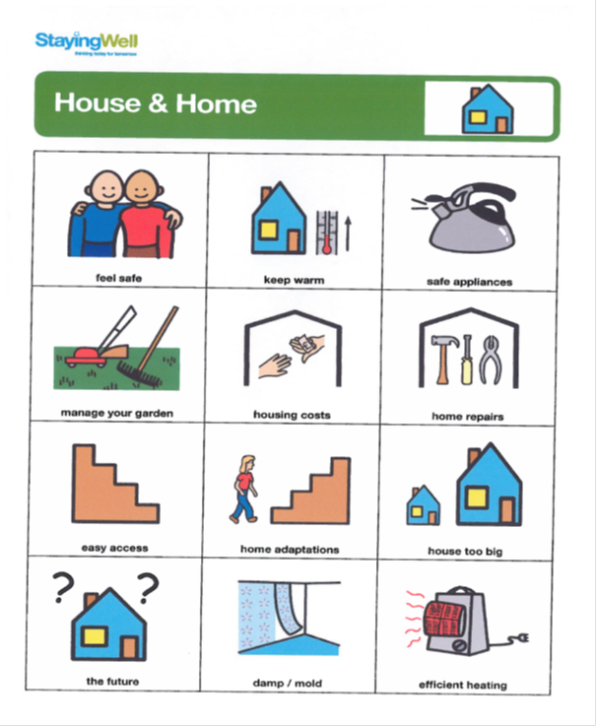
Communication Cards
Complements the Quality of Life Wheel
Supports conversation
Overcome communication and language barriers

Slide 12
Trigger Questions
Have you any concerns about living arrangements in your house/home?
Is your home the right size for your needs? | Yes | No
Can you easily access and get around your home? | Yes | No
Would you benefit from any adaptations being made to your home? | Yes | NO
Do you need help with repairs to your home? | Yes | NO
Does your home suffer from damp or mould? | Yes | No
Can you keep your home warm during the winter? | Yes | No
Are you able to manage your housing costs? | Yes | No
Do you think your home will be suitable for you in the future? | Yes | No
Used when client scores 0-2 on the Quality of Life Wheel
Enables focused conversation around specific needs and assets
Developed jointly with services

Slide 13
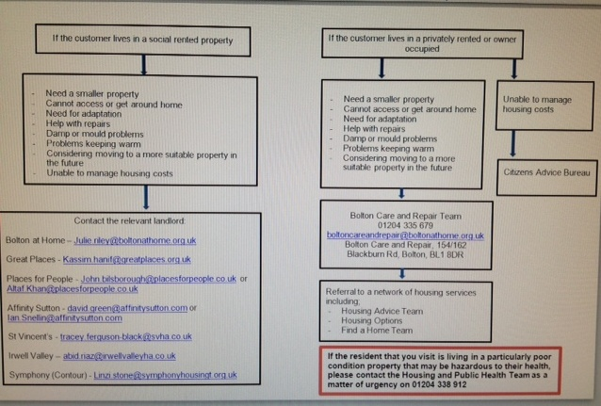
Algorithms
Effectively target appropriate support/resources
Take unnecessary demand out of the system
Not an exhaustive list
Notes:
Electronic Caseload Management Tool Developed
Effectively manage caseload
Track actions/status
Add client history
Opportunities to upscale by linking to Access Bolton and other Services

Slide 14
Monitoring & Evaluation
How Staying Well is running
Client demographics and uptake rates
Client needs identified
Responsiveness of services
What Staying Well is achieving
Before and after score of the quality of life wheel –measure improvements
Changes in key measures (e.g. better sleep, less isolated, able to get out and about after receiving the intervention
Case studies
What Staying Well is costing/saving
GM cost benefit analysis tool
Costs identified from case studies
Cost associated with delivering the Staying Well intervention

Slide 15
Integrated Neighbourhood Teams
Nurses, Social Workers, Pharmacists, Mental Health workers, Therapists, admin support
INT Co-located and aligned to Hubs
EOLC, Frail Elderly, LTC including Dementia
District Nurses, Falls & Community Therapy and Long Term Conditions Teams aligned to Hubs

Slide 16
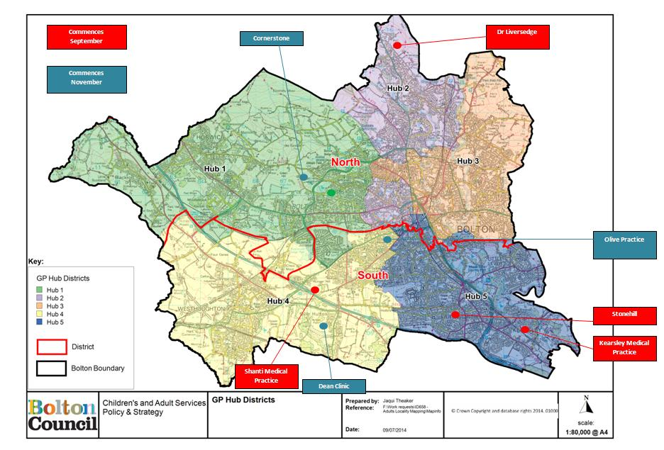

Slide 17
Team Toolkit
Generic Assessment Tool
Health and Wellbeing Plan
Keyworker Role
Standard Operating Procedure
GP Practice Links

Slide 18
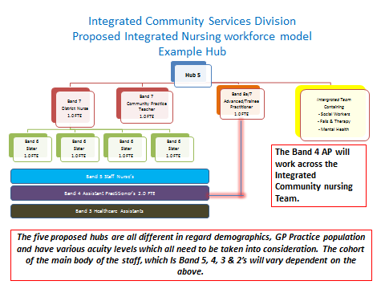
Workforce Redesign

Slide 19
Challenges
Adaptation to new ways of working
Keyworker Role predominantly undertaken by nurses and social workers
Proactive versus Reactive Care Model
Need for Culture Change

Slide 20
Culture Club Background
Integration of more than one organisation each with a well-established culture.
Acknowledgement that unifying cultures might be difficult and a sense that it was more complex than the co-location of staff sharing a premise.
Use of external consultants for an independent perspective.
Desire to be authentically person centred and to listen and respond to people with direct experience of delivering and receiving services.

Slide 21
Details of Product
Half day course for all staff (courses adapted for different practitioners, team leaders, and senior managers). Opportunity for reflection, conversation and new insights.
Individual assessment by attendees of the organisations ability to support / stifle person centred care.
Written commitment from individuals to change personal practice.
Suggestions from individual employees to promote person centred care.
Active support to implement and sustain change.

Slide 22
Workforce Benefits
Shared understanding of what authentic person centred care looks like.
Articulation of values and principles going forward including the principle that being person centred towards staff, is as important as person centred care.
Staff identify potential positive change.
Action planning in progress to implement change.

Slide 23
Attendance & Evaluation
80+ Integrated team members have attended thee training to date.
A further 20 Culture Club courses are scheduled to take place in November / December / January 2016.
Quotes from Evaluation following the course
I intend to adopt a more person centred approach in my practice by:
‘’Considering mental health as important as physical health’’
’Make a point of highlighting positive attributes of a person, and what they have to offer rather than just focusing on what support is needed. Even if we don’t think it is important’’
‘’Being more mindful of other roles within the team and what they have to offer a person, not just looking at what I can offer from my own profession’’
‘’Continuing to place customers at the centre of all interventions’’
‘’Keeping lines of communication open’’

Slide 24
Embedding of Culture Club Principles
‘’Apply intelligent principles when bringing services under one umbrella’’
‘’Prepare existing services and colleagues for the introduction of new concepts to enable them to embrace new ways of working’’
‘’Positively encourage the challenging of existing practice, empowering colleagues to instigate change for better’’
‘’Work on enabling access to systems from different organisations / agencies, to enable better communication and information gathering regarding people that cross over form different organisations / agencies particularly social care, heath & mental health’’
‘’Be less risk averse so that ‘one size does not fit all’ and make other options available.

Slide 25
Evaluation to Date
The approach is acknowledged as challenging but necessary commitment to a pro-active, holistic, approach to creating a person centred culture.
Still a work in progress however, there is clear commitment to the philosophy and values.
There has been significant learning about the pro-activity needed from an organisation to support a person centred culture.

