Slide 1
Devon Doctors - GP portfolio role
Tuesday, May 22, 2018

Slide 2
25
Total Responses
Date Created: Monday, March 26, 2018
Complete Responses: 21

Slide 3
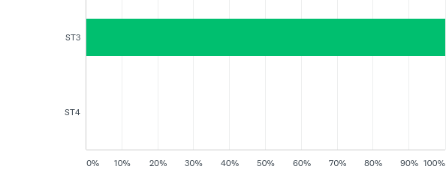
Q1: What year of training are you in?
Answered: 25 Skipped: 0

Slide 4
Q1: What year of training are you in?
Answered: 25 Skipped: 0

Slide 5
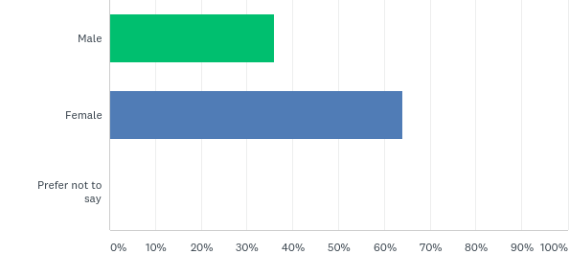
Q2: What is your gender?
Answered: 25 Skipped: 0

Slide 6
Q2: What is your gender?
Answered: 25 Skipped: 0

Slide 7
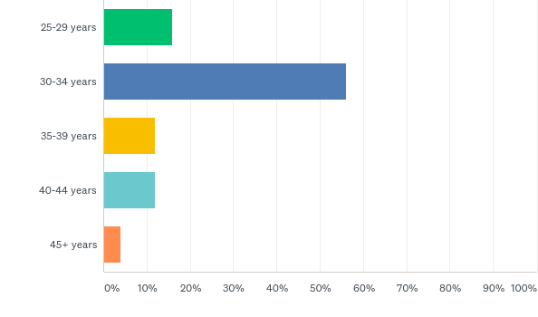
Q3: What is your age?
Answered: 25 Skipped: 0

Slide 8
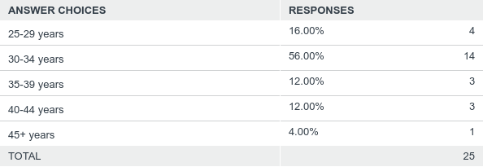
Q3: What is your age?
Answered: 25 Skipped: 0

Slide 9
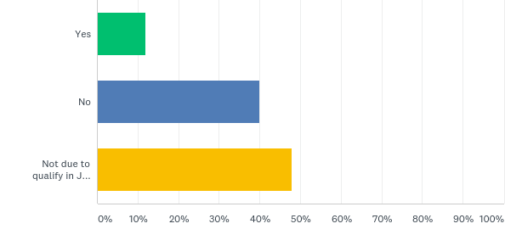
Q4: If you are due to qualify in July 2018, have you already secured your first job?
Answered: 25 Skipped: 0

Slide 10
Q4: If you are due to qualify in July 2018, have you already secured your first job?
Answered: 25 Skipped: 0

Slide 11
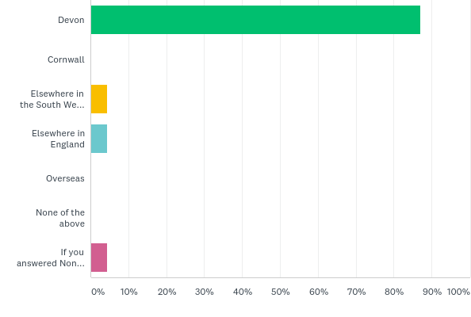
Q5: In which location would you prefer to work after qualifying?
Answered: 23 Skipped: 2

Slide 12
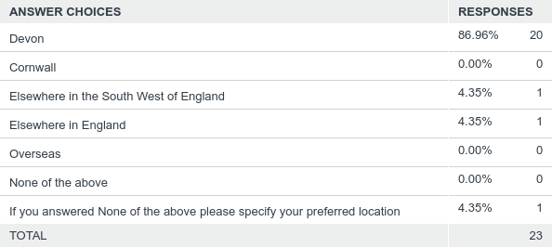
Q5: In which location would you prefer to work after qualifying?
Answered: 23 Skipped: 2

Slide 13
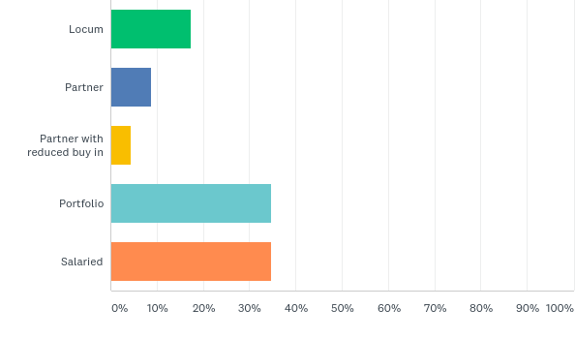
Q6: What would be your preferred first role after qualifying?
Answered: 23 Skipped: 2

Slide 14
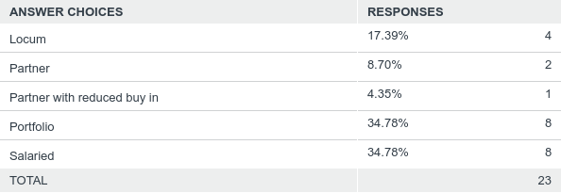
Q6: What would be your preferred first role after qualifying?
Answered: 23 Skipped: 2

Slide 15
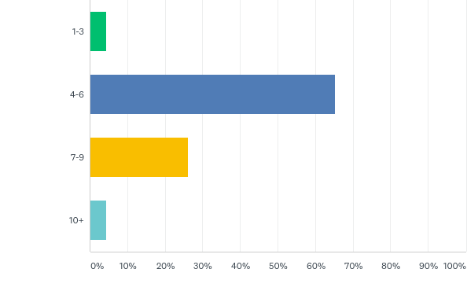
Q7: How many sessions would you prefer to work after qualifying?
Answered: 23 Skipped: 2

Slide 16
Q7: How many sessions would you prefer to work after qualifying?
Answered: 23 Skipped: 2

Slide 17
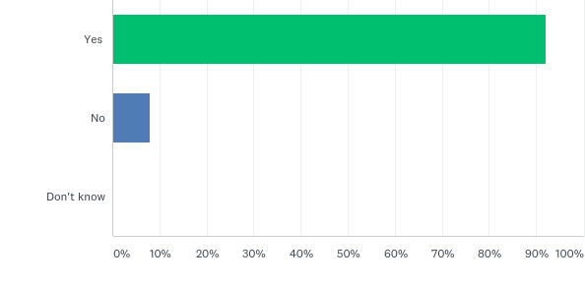
Q8: Would portfolio work be of interest to you?
Answered: 25 Skipped: 0

Slide 18
Q8: Would portfolio work be of interest to you?
Answered: 25 Skipped: 0

Slide 19
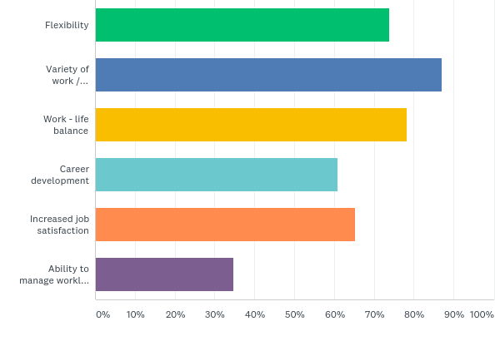
Q9: What makes portfolio work of interest? Tick all that apply
Answered: 23 Skipped: 2

Slide 20
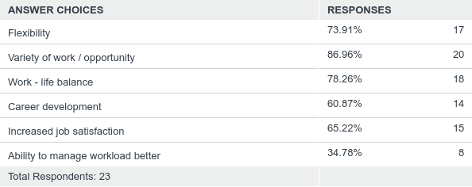
Q9: What makes portfolio work of interest? Tick all that apply
Answered: 23 Skipped: 2

Slide 21
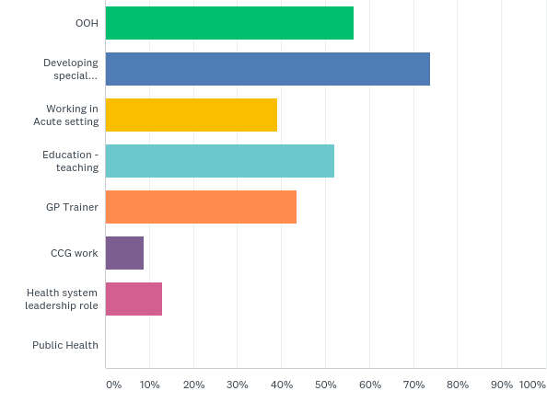
Q10: What type of portfolio work would be of interest to you? Tick all that apply
Answered: 23 Skipped: 2

Slide 22
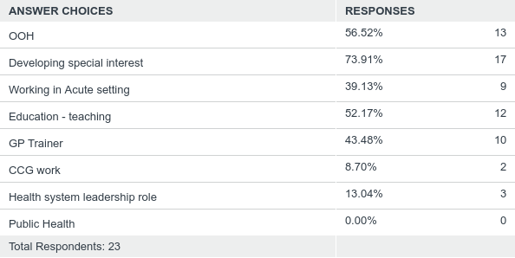
Q10: What type of portfolio work would be of interest to you? Tick all that apply
Answered: 23 Skipped: 2

Slide 23
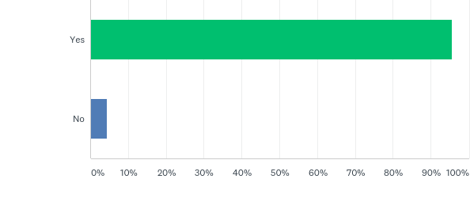
Q12: Would a salaried role that combined general practice with 'out of hours' and some acute work be of interest?
Answered: 23 Skipped: 2

Slide 24
Q12: Would a salaried role that combined general practice with 'out of hours' and some acute work be of interest?
Answered: 23 Skipped: 2

Slide 25
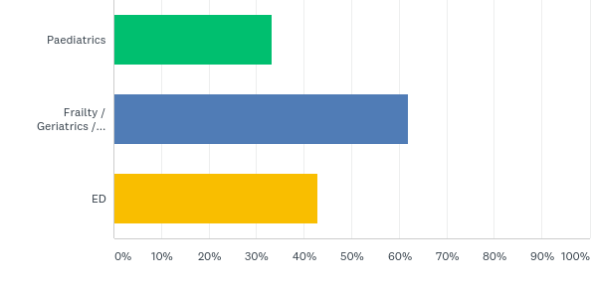
Q13: If you answered yes to the previous question, what acute work would be of interest
Answered: 21 Skipped: 4

Slide 26
Q13: If you answered yes to the previous question, what acute work would be of interest
Answered: 21 Skipped: 4

Slide 27
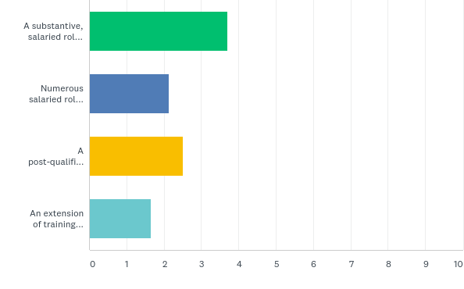
Q14: What would be your preferred option for portfolio working? (Please rank the following (1=most preferred option; 4=least preferred option)
Answered: 23 Skipped: 2

Slide 28
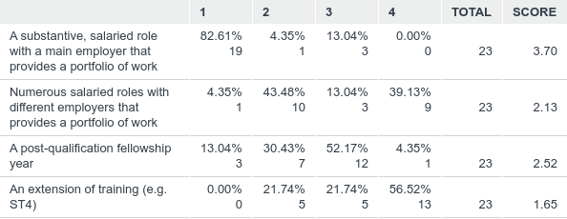
Q14: What would be your preferred option for portfolio working? (Please rank the following (1=most preferred option; 4=least preferred option)
Answered: 23 Skipped: 2

Slide 29
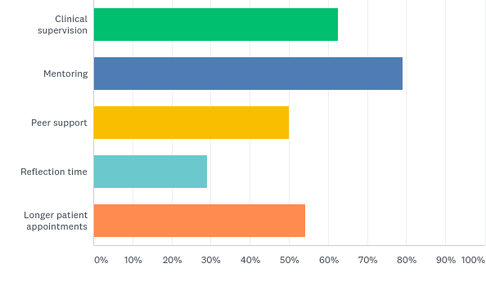
Q15: What type of support would you like to see provided to you as part of your first role post-qualification?
Answered: 24 Skipped: 1

Slide 30
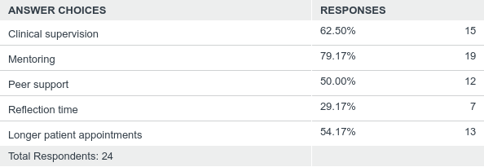
Q15: What type of support would you like to see provided to you as part of your first role post-qualification?
Answered: 24 Skipped: 1

Slide 31
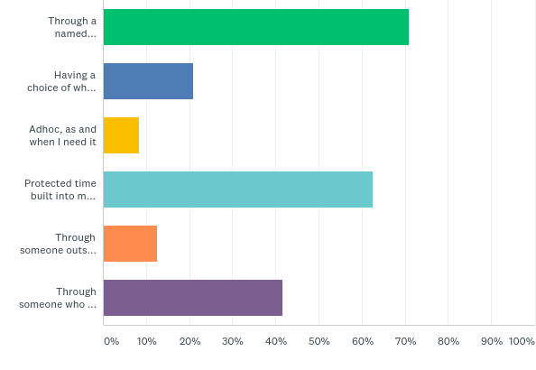
Q16: How would you like to access support? Tick all that apply
Answered: 24 Skipped: 1

Slide 32
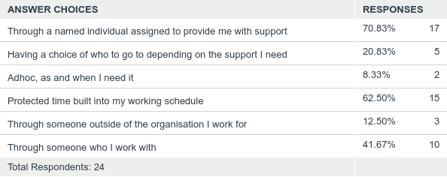
Q16: How would you like to access support? Tick all that apply
Answered: 24 Skipped: 1

Slide 33
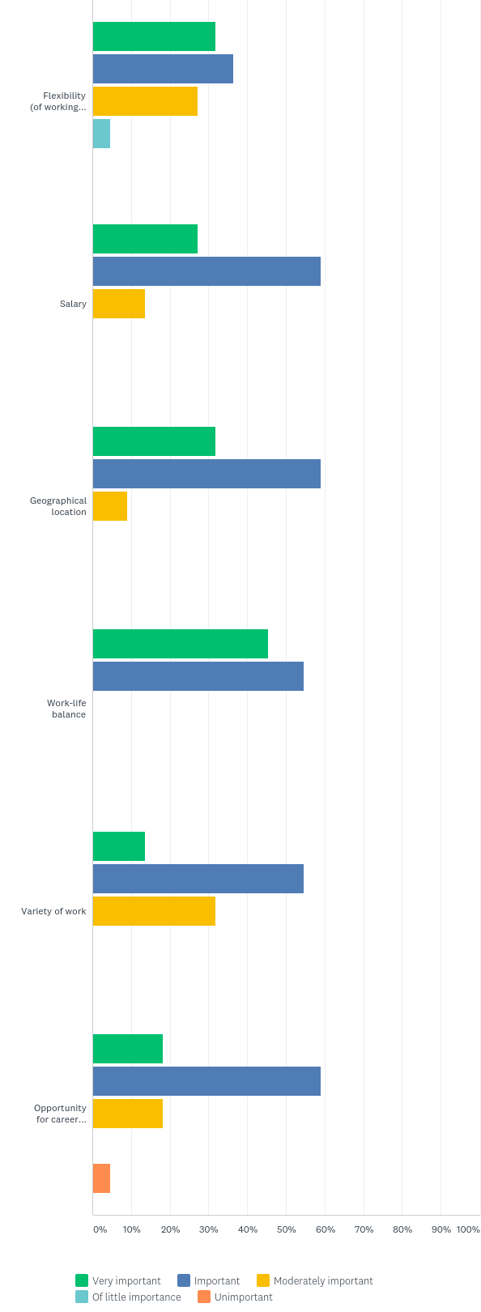
Q17: How important are the following factors when considering your first role post-qualification?
Answered: 22 Skipped: 3

Slide 34
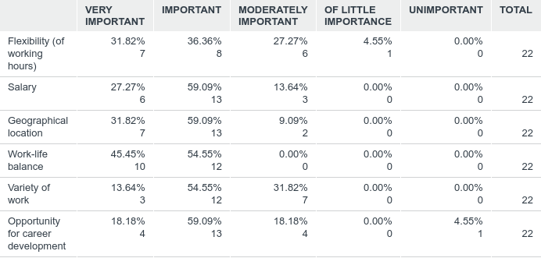
Q17: How important are the following factors when considering your first role post-qualification?
Answered: 22 Skipped: 3

Slide 35
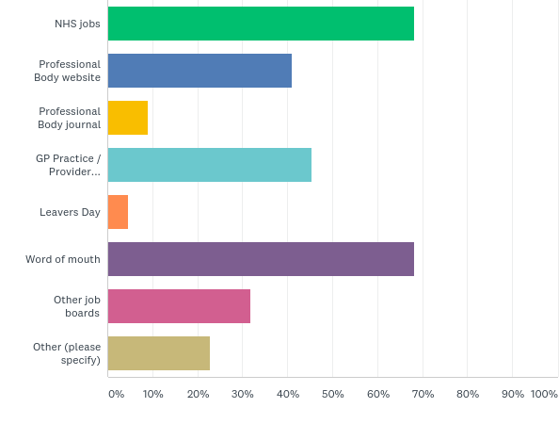
Q18: What channels will you use / are you using to search for your first job after qualifying? Tick all that apply
Answered: 22 Skipped: 3

Slide 36
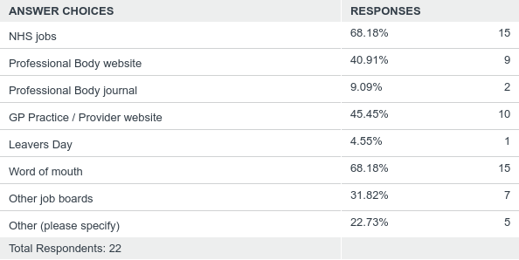
Q18: What channels will you use / are you using to search for your first job after qualifying? Tick all that apply
Answered: 22 Skipped: 3

Slide 37
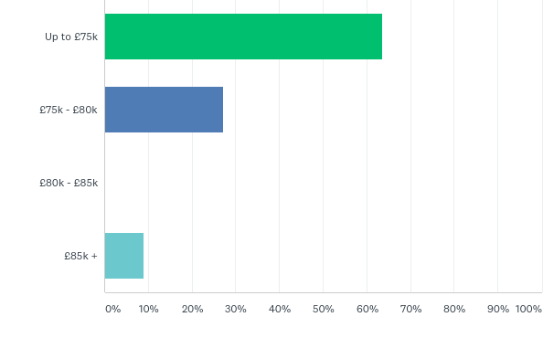
Q19: What salary range do you expect for your first role post-qualification?
Answered: 22 Skipped: 3

Slide 38
Q19: What salary range do you expect for your first role post-qualification?
Answered: 22 Skipped: 3

