Slide 1





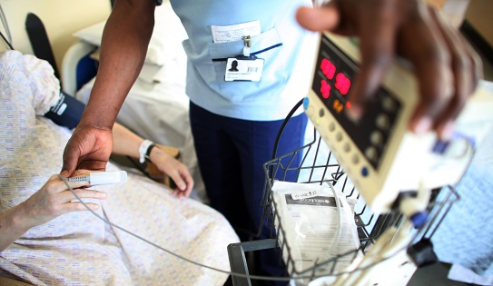
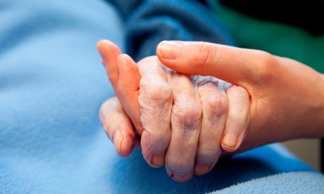

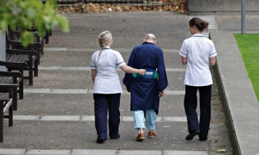

Learning Matters
Workshop 2 - Effective Communication
Giving and Receiving Feedback
TraDate
Presenter: Christine Clegg – Practice Educator Facilitator
Facilitator: Lynn O’Reilly – Work Based Educator
Developing People for Health and Health Care

Slide 2
Aims/Objectives
Explain what is feedback
Identify what makes effective feedback
Demonstrate verbal and written feedback

Slide 3
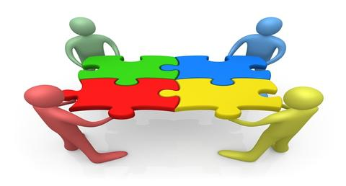
Developing people for health care
What is feedback?
Why is it an important communication skill?
Notes:
Groups to use flip chart – 5-10 minutes
So What is Effective Feedback? “The main purpose of feedback is to reduce discrepancies between current understandings and performance and a goal” (Hattie & Timperley, 2007,p.86).Michael Absolum, (2006, p.127):
“Feed forward is where pointing to the next learning steps illuminates aspects of current performance.” The student keeps track of where they are going and the teacher helps bybuilding “into the feedback a sense of future focus” (Absolum, 2006, p.127)
“Various research studies have concluded that feedback is most useful when it focuses on the learning intention of the task rather than other features of the work” (Clarke, Timperley, & Hattie, 2003, pp.57-58).
Stone & Heen Lecturers at Harvard Law School Giving feedback is not typical with most people’s norms because it seems impolite or rude to point out weakness.
Yet feedback is central to:
supporting cognitive, technical and professional development.
Patient Care
Communication and Leadership
Effective feedback, however, shows where we are in relationship to the objectives and what we need to do to get there..
It tells us how we performed, how to improve the next time.
Facilitative feedback rather than directive enhances learning for high achievers
High achieving recipients undertaking complex tasks may benefit from delayed feedback
Feedback should focus on the task rather than the individual and should be specific and directly linked to personal goals
Are you in a feedback culture?
Early training experience such as peer feedback may over time support the cultural change.
Opportunities must not be missed
Corner stone to clinical teaching it can be written, verbal or numerical
Feedback can promote learning if it is received mindfully

Slide 4
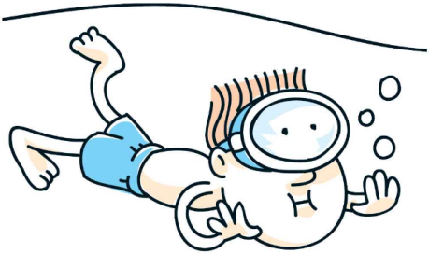
Where did the swim of feedback begin?
Before you tell me how to do it better, before you lay out your big plans for changing, fixing, and improving me, before you teach me how to pick myself up and dust myself off so that I can be shiny and successful – know this: I’ve heard it before.
I’ve been graded, rated, and ranked. Coached, screened and scored. I’ve been picked first, picked last, and not picked at all. And that was just Kindergarten!
Notes:
Before we’ve left Primary School we’ve been handed back assignments, papers, and tests. Assessed for school plays. Given ratings. Scores.

Slide 5
Activity
Step 1 - Build a model of a really fast animal using Lego in 3 minutes.
Step 2 - Buddy up with the person next to you and describe what you built to your partner and let them do the same.
Step 3 - Now give your partner feedback and let them do the same.
Think point :Consider the words of the feedback, how did that impact on you?
Notes:
10 Minute activity
3 minutes to complete animal
2 minutes each to feedback to one another (7 Minutes)
3 minutes to feedback to the group) (10 Minutes

Slide 6
Scenario – Giving Written Feedback
Group Activity
Notes:
Give out Scenario to the three groups
15 Minutes to read complete activity and feedback give out P@RE Evaluation Sheet

Slide 7

Challenges of Feedback
  What are some of the challenges to giving and receiving direct feedback about our work?
Notes:
Flipchart - Faciliators to engage audience ((take 5 Minites)
Defensiveness of receiver feedback
Generic shallow feedback
Maslow’s Hierarchy of Needs – How are YOU when giving and receiving feedback e.g. tired, hungry, thirsty – is it the best time to deliver and receive feedback
Depending where we are on our learning journey we might need a different level of feedback
Most of us think we know about what makes good feedback. Positive comments are better, and more useful than negative ones. How do you give feedback?
Professor Ayelet Fishbach a professor of behaviour science and marketing at the University of Chicago, in her research paper
“Tell Me What I Did Wrong” found that feedback givers who were supposed to indicate to another that performance was not great, and that they needed to improve and where it needed to be, found from reviewing the survey, the recipients of the feedback given thought they were doing great. This indicates that the msg what not successfully conveyed.
She also said that people giving feedback frequently didn’t give enough information, offered too late, the feedback was focussed on something wrong .
Words are very powerful and using words like “and” or “what if”, rather than “but” is a way to offer to suggestions and allow development without fear.
Brain scans of people show that judgemental language – or even being told you have to do things in a certain way – lead to self-censoring.

Slide 8
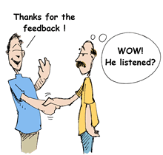
Effective Communication
Consider this key leadership characteristic and its relevance in enhancing /improving care for peers, educators and service users.
How would you rate your communication skills?
Notes:
Give out questionnaire
5 minutes
Exercise – rate yourselves on each element of the above (Give out sheet). When you go back to your area ask for feedback from your educator or peer.
Consider the factors which we have touched on today which hinder/promote feedback and how this skill can enable you and others to promote positive develop which ultimately impacts on patient/service user delivery.
1 extremely comfortable 7 extremely anxious
Write on page 14 of your workbook
Discuss possible use of asking team members to rate you….

Slide 9
Communication
Telephone Skills
Thinking through in advance what you want to say
Presenting
Employing a logical order & structure. Using visual aids effectively. Building rapport with your audience.
Giving & Accepting criticism
Saying sorry in assertive, not passive way. Allowing disagreements to be brought into the open. Using the praise sandwich when criticising
Motivating & Supporting
Giving Praise. Giving encouragement. Giving thanks for praise or help. Working well in a team.
Spoken Communication
Persuading & Negotiating
Getting an agreement acceptable to both sides: win:win. Backing up points with logic. Showing tact to those you disagree with.
Gathering Information
Asking open & probing questions to understand views & feelings of others. Clarifying & summarising what they are saying
Listening
Accurately hearing what people are saying & expressing interest. Showing empathy.
Body Language
Using it yourself & being sensitive to its use by others: eye contact, gestures, head nodding, smiling, open posture.
Notes:
5 minutes
Exercise – rate yourselves on each element of the above (Give out sheet). When you go back to your area ask for feedback from your educator or peer.
Consider the factors which we have touched on today which hinder/promote feedback and how this skill can enable you and others to promote positive develop which ultimately impacts on patient/service user delivery.
1 extremely comfortable 7 extremely anxious
Write on page 14 of your workbook
Discuss possible use of asking team members to rate you….
Attitudinal Assessment Tool – Page 15 of workbook - discuss

Slide 10
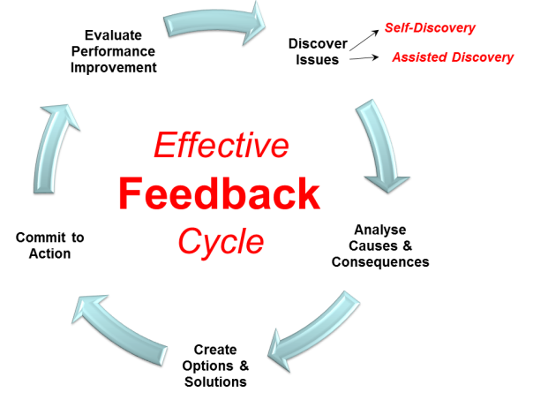
So what is effective feedback?
Notes:
Recap on Work shop 2 minutes
Lesson objectives: :
Identify what feedback is
Explain what makes effective feedback
Demonstrate verbal and written feedback
Evaluation on Flip Chart
Using your post it notes in your pack Write one or more examples that you will take away from this workshop

Slide 11

3 good things exercise.........and one act of kindness
Notes:
3 good things and one act of kindness

Slide 12



Thank you for Participating
Thank you for Participating
Notes:
Introduce Mo Brown

